Slide 1




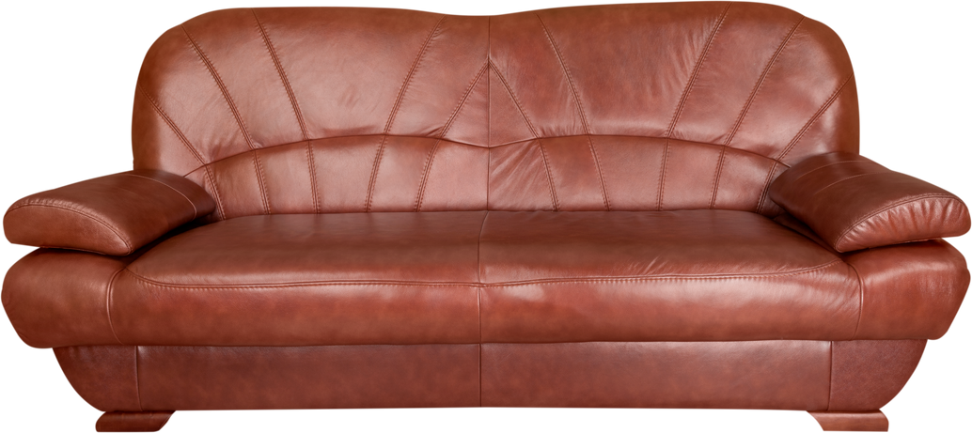
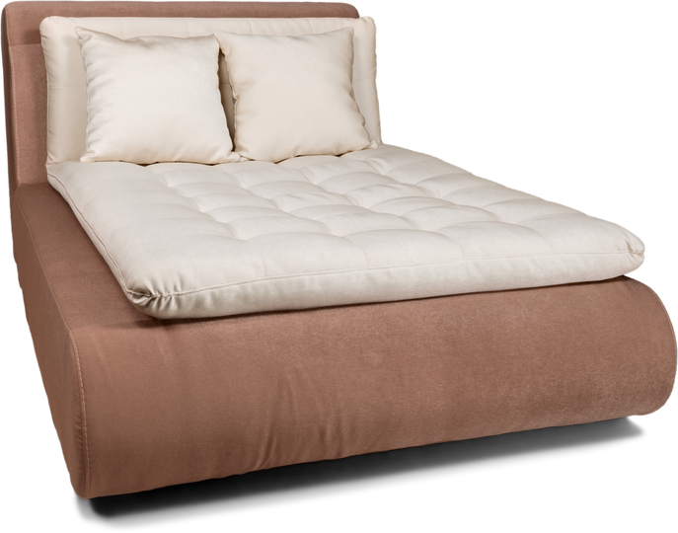
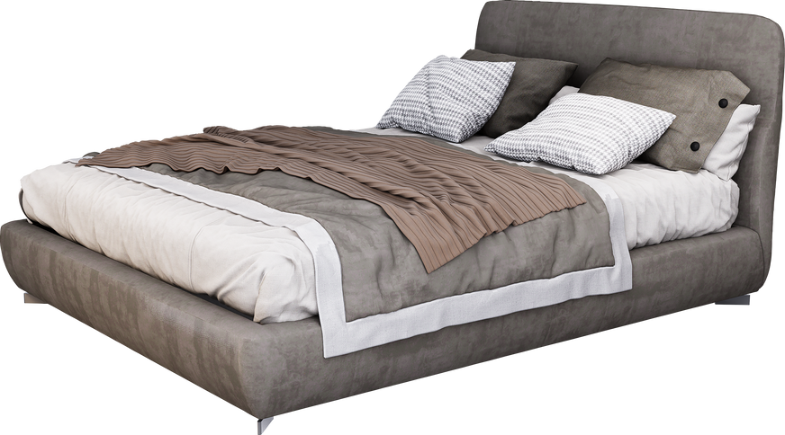
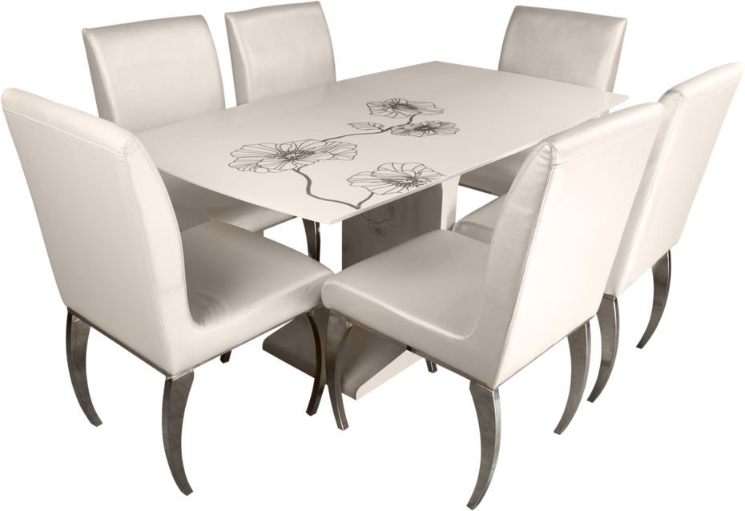
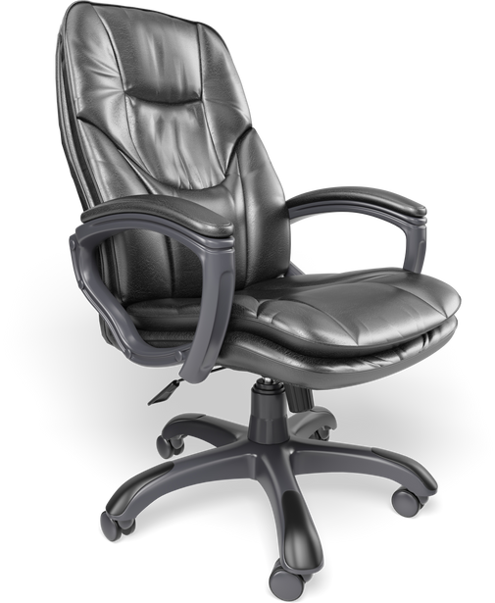
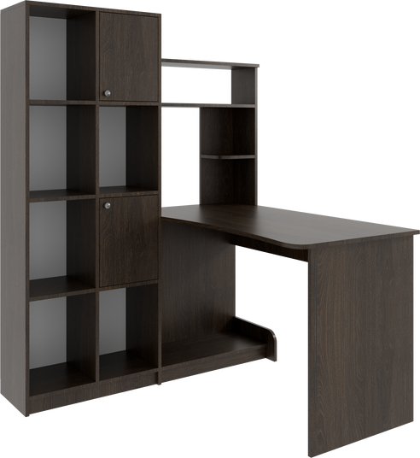

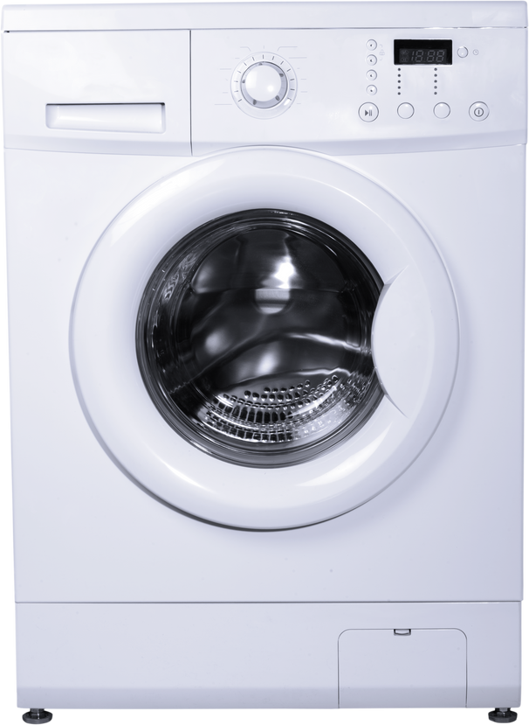
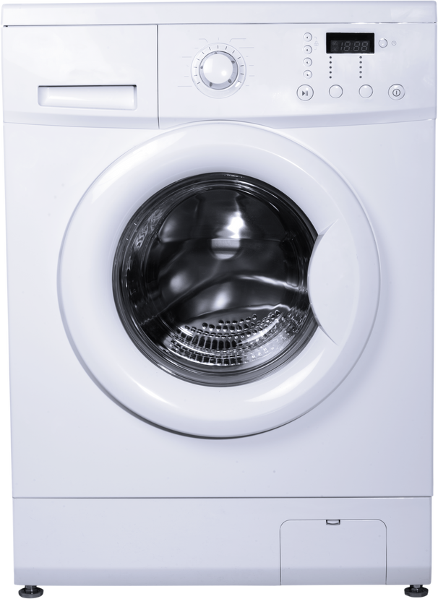
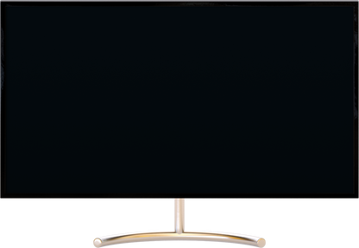

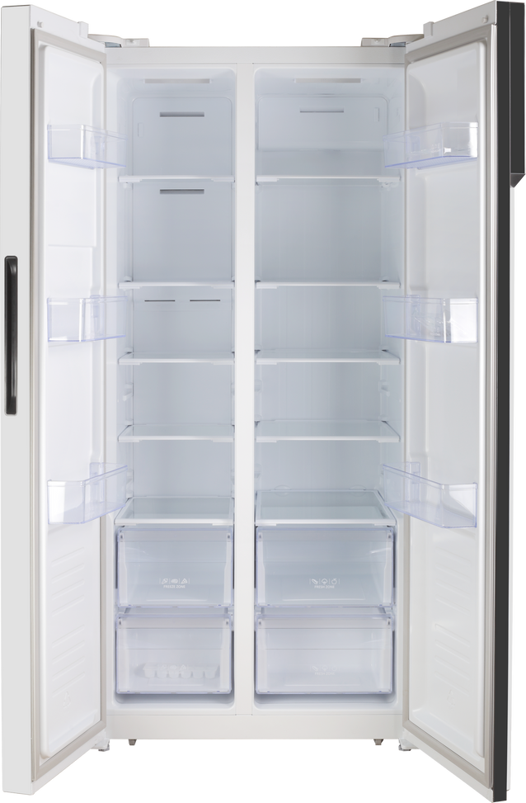
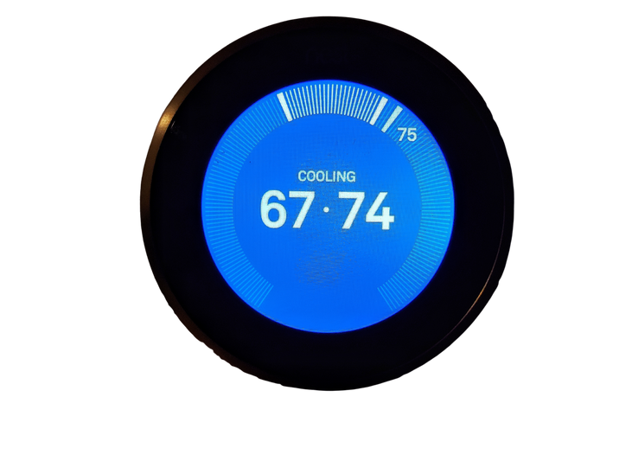
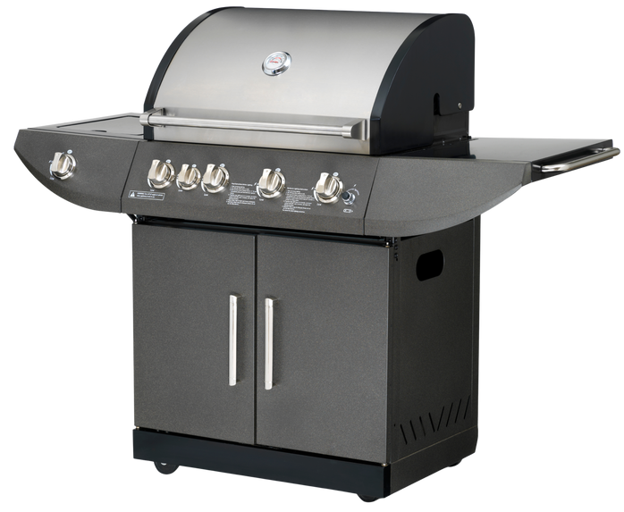


WARNER
Furniture
LABOR DAY
GET UP TO
60
% OFF
MEGA SALE
UPGRADE YOUR HOME FOR LESS
1-4 September, 2025
FURNITURE DEALS
Leather Recliner Sofa
$1,299.00
Queen Memory Foam Mattress
$799.00
King Bed Frame with Storage
$1,099.00
$
799
499
749
.00
$
.00
$
.00
$899.00
$249.00
Modern Bookshelf
(5-Tier)
$399.00
Piece Patio Dining Set
$
549
Adjustable Office Chair
149
259
.00
$
.00
$
.00
ELECTRONIC DEALS
$799.00
Stainless Steel French Door Refrigerator
$1,499.00
Front-Load Washing Machine
$999.00
65” 4K Smart TV
$
529
999
699
.00
$
.00
$
.00
$199.00
$499.00
Portable Bluetooth Speaker
$149.00
Smart Thermostat
$
129
Gas Grill BBQ (4-Burner)
329
89
.00
$
.00
$
.00
FREE LOCAL DELIVERY
Warner Furniture
123 Anywhere St., Any City
www.reallygreatsite.com hello@reallygreatsite.com @reallygreatsite

