Slide 1



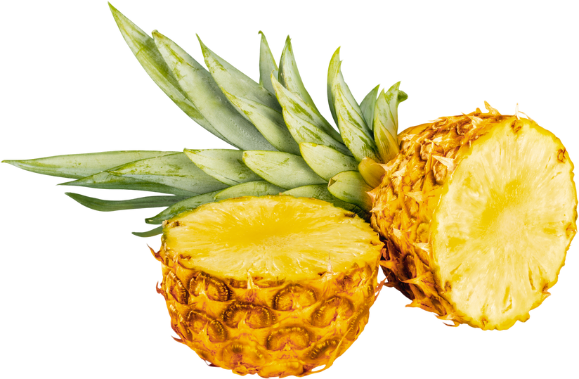
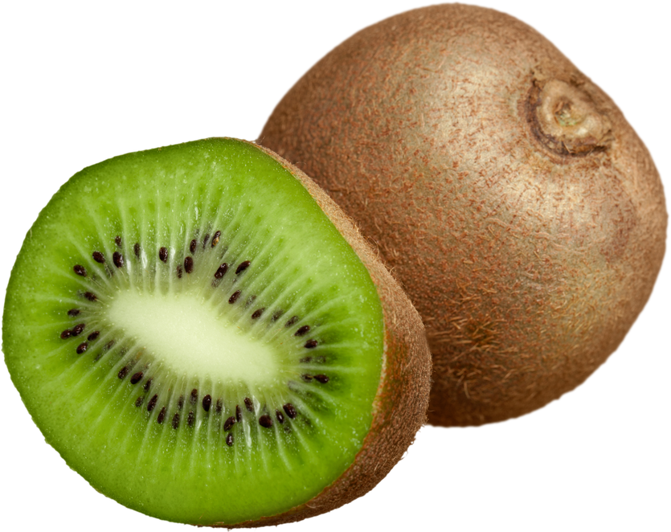
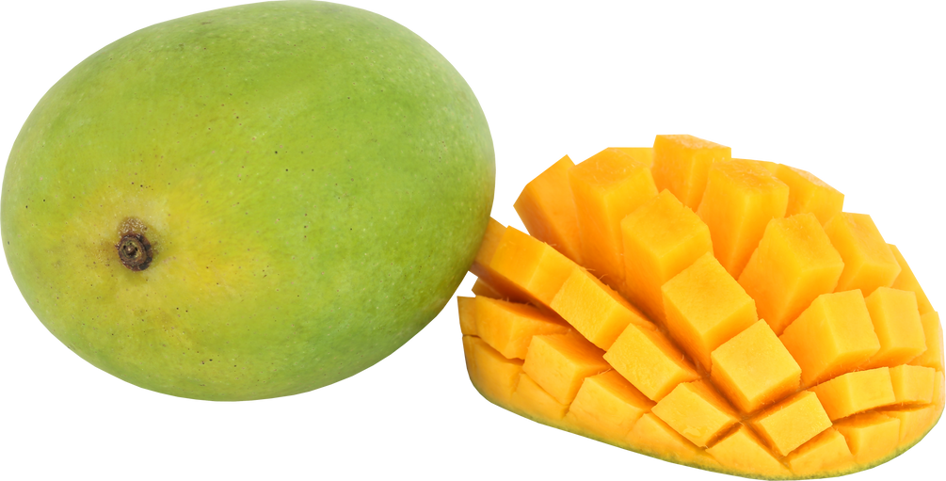
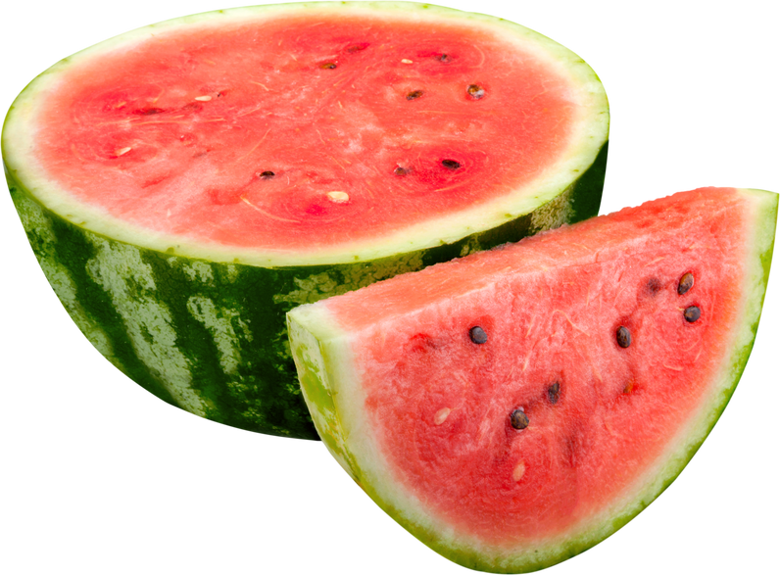
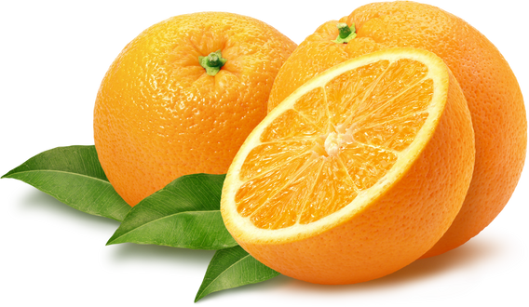
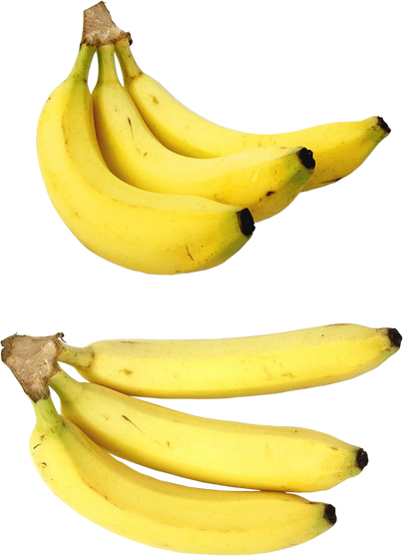


@reallygreatsite
Special Promo
Start your healthy lifestyle with our varieties of freshly picked and great-quality fruits from the local farmers.
20%
OFF
20%
OFF
20%
OFF
Pineapple
Kiwi
Mango
$5.14 /kilogram
$5.14 /kilogram
$5.14 /kilogram
10%
OFF
10%
OFF
10%
OFF
Watermelon
Orange
Banana
$5.14 /kilogram
$5.14 /kilogram
$5.14 /kilogram
+123-456-7890
123 Anywhere St., Any City

