Slide 1



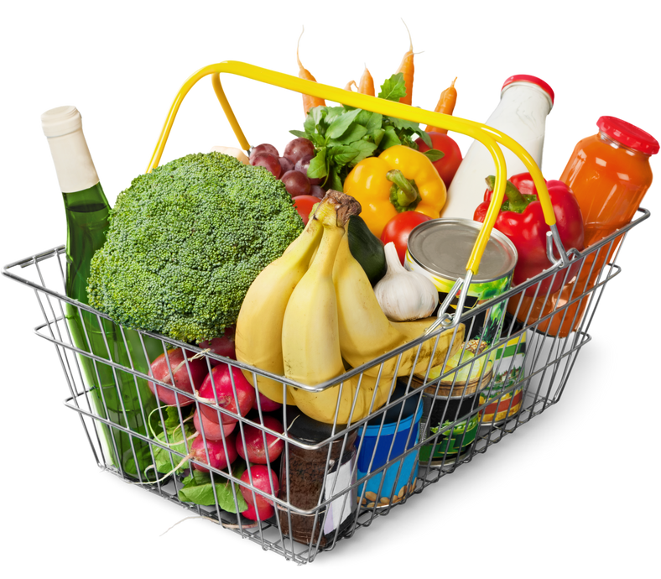
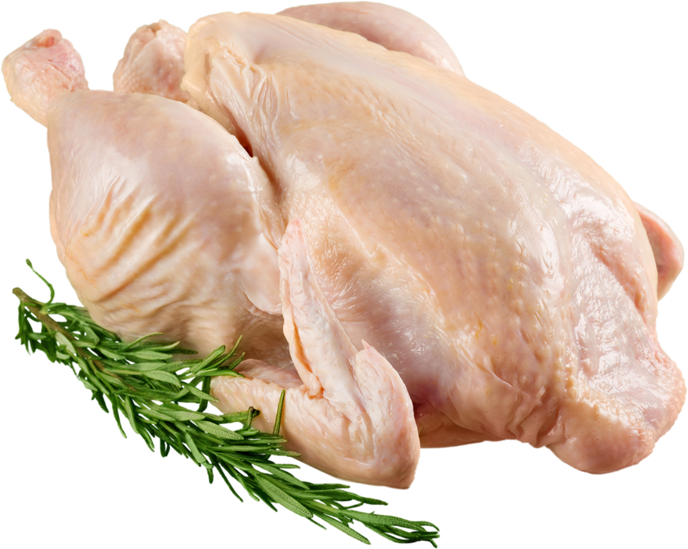
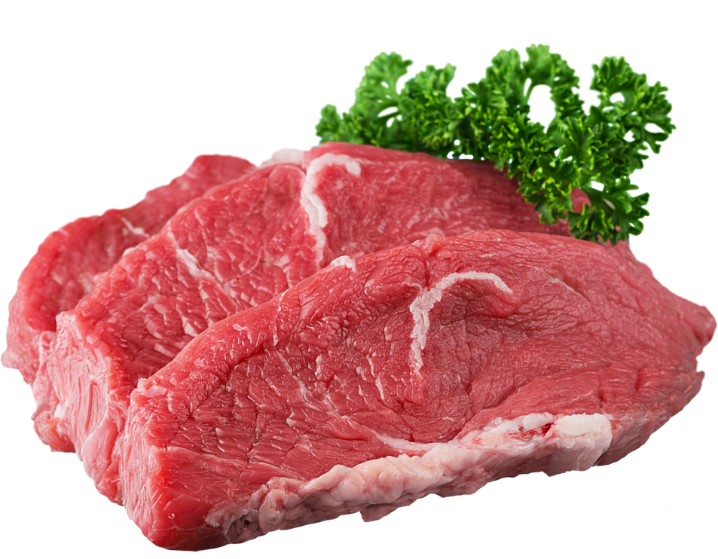
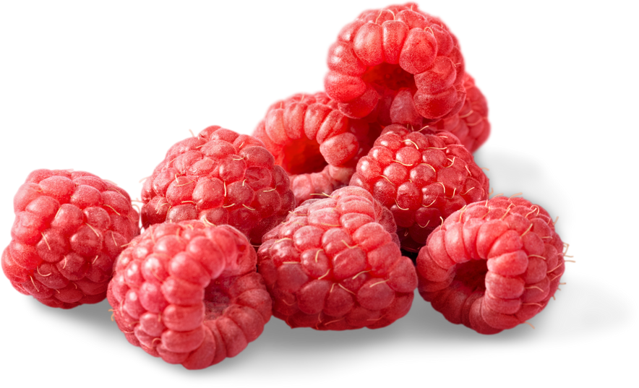
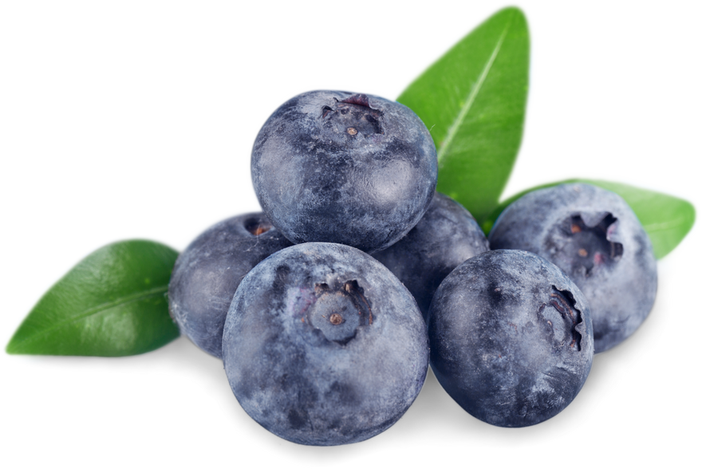
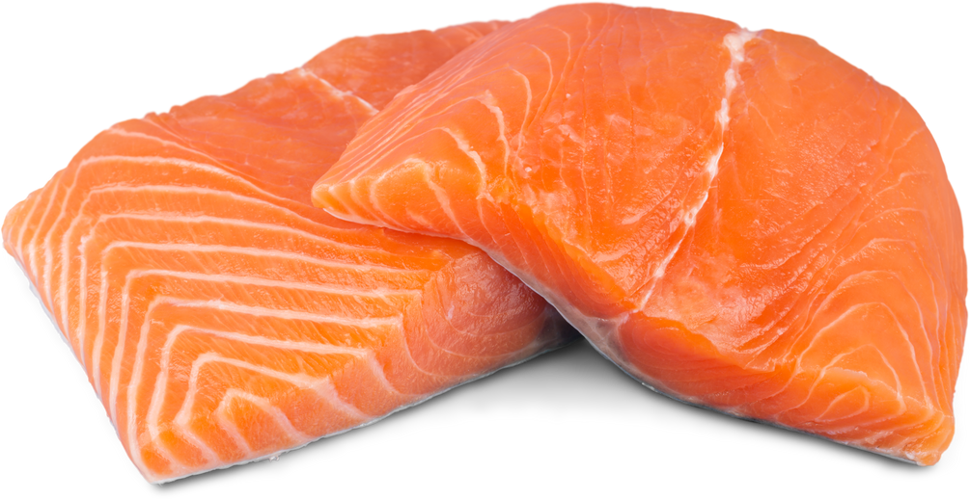
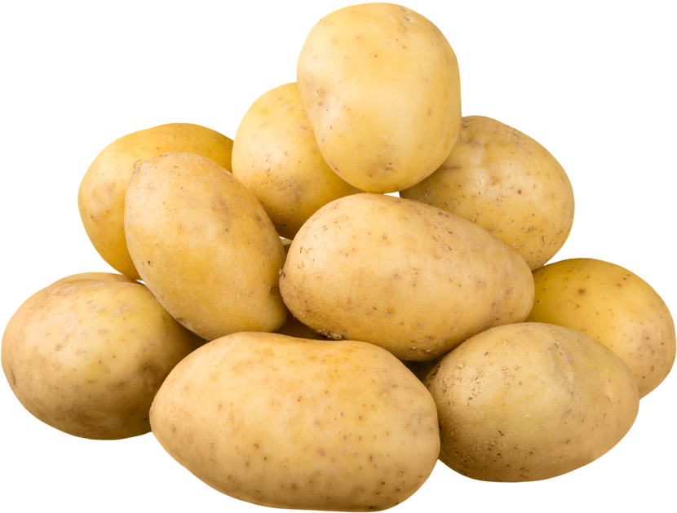
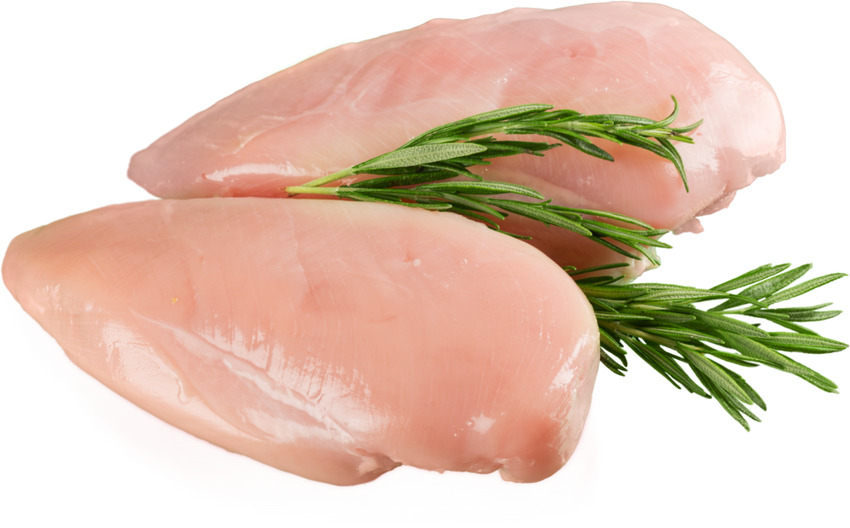
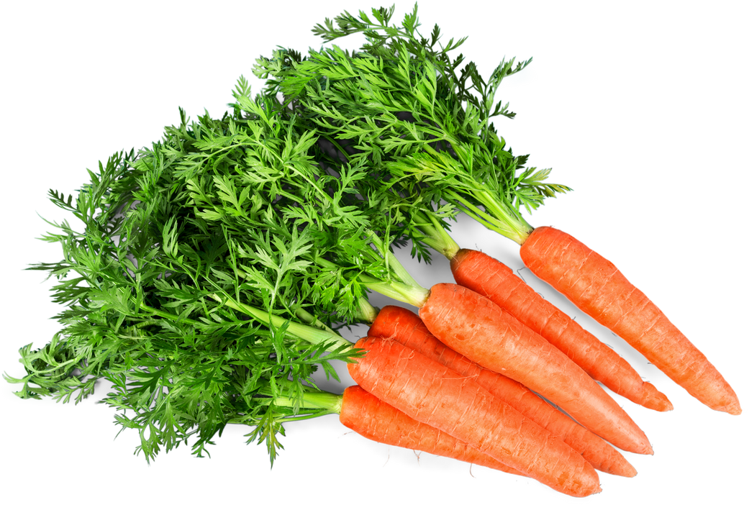



WARNER & SPENCER
Christmas
Christmas
DEALS
UP TO
50
%
OFF
8 - 15 DECEMBER, 2024
$ 12
$ 17
$ 13
FRESH WHOLE CHICKEN
/KG
FRESH RAW BEEF
/KG
/KG
FRESH RASPBERRIES
$ 11
$ 15
$ 10
/KG
FRESH RAW SALMON
/KG
/KG
FRESH BLUEBERRIES
POTATOES
$ 14
$ 10
$ 12
FRESH CHICKEN BREAST
/KG
FRESH CARROTS
/KG
FRESH LEMONS
/KG
+123-456-7890
REALLYGREATSITE.COM

