Slide 1

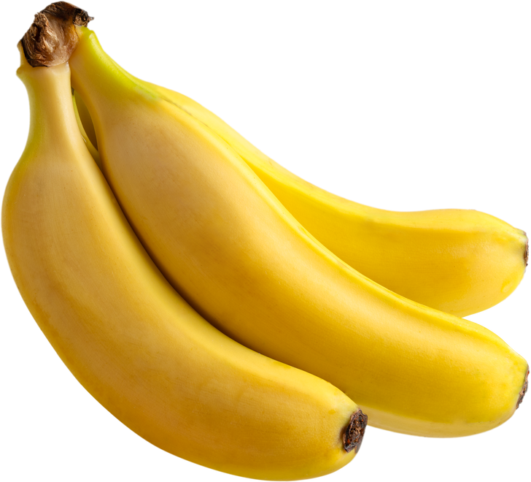
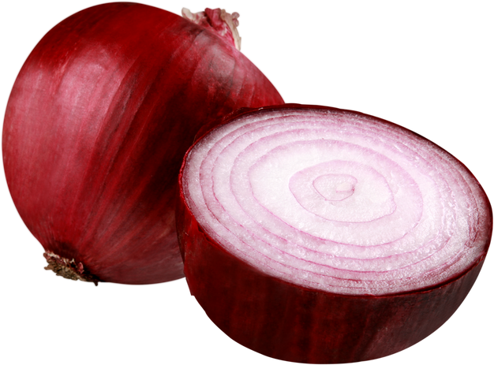
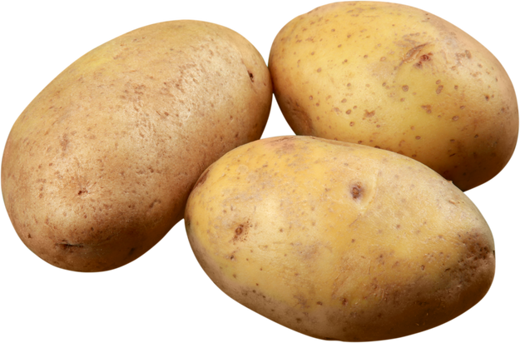
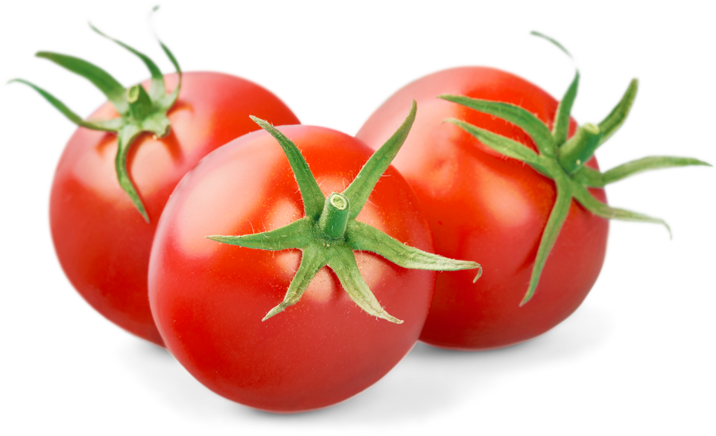

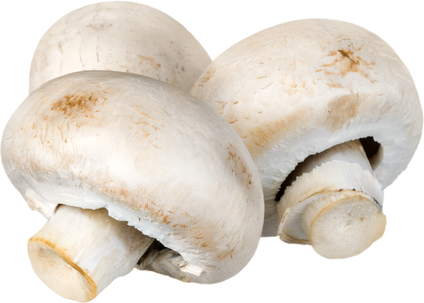
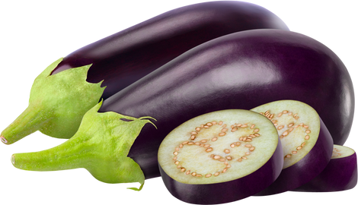
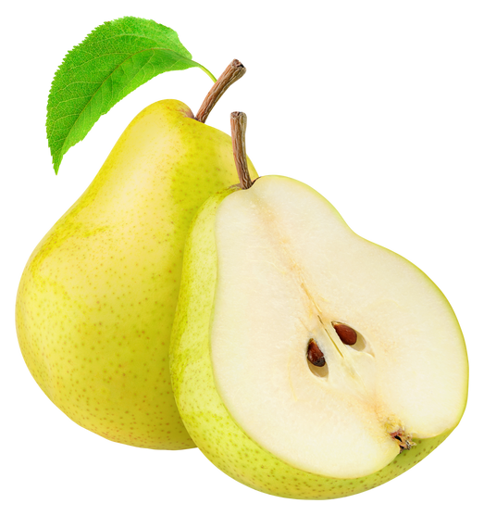



MEGA
SALE
LICERIA & CO.
1-10 MARCH 2026
GROCERY
UP TO 50%OFF
30%
OFF
20%
OFF
BANANA
ONIONS
Bananas are sweet, soft, perfect for snacks.
Fresh onions, essential for cooking.
500 g
$7
500 g
$9
25%
OFF
40%
OFF
POTATOES
TOMATOES
Fresh potatoes, ideal for cooking for baking.
Juicy tomatoes, great for salads.
500 g
$8
500 g
$11
20%
OFF
45%
OFF
EGGS
MUSHROOMS
Fresh eggs, perfect for baking or breakfast.
Fresh, earthy mushrooms for cooking.
500 g
$15
500 g
$7
35%
OFF
30%
OFF
EGGPLANT
PEARS
Fresh eggplant, perfect for grilling.
Juicy pears, ideal for snacking.
500 g
$12
500 g
$5
+123-456-7890
123 Anywhere St., Any City
www.reallygreatsite.com

