Slide 1
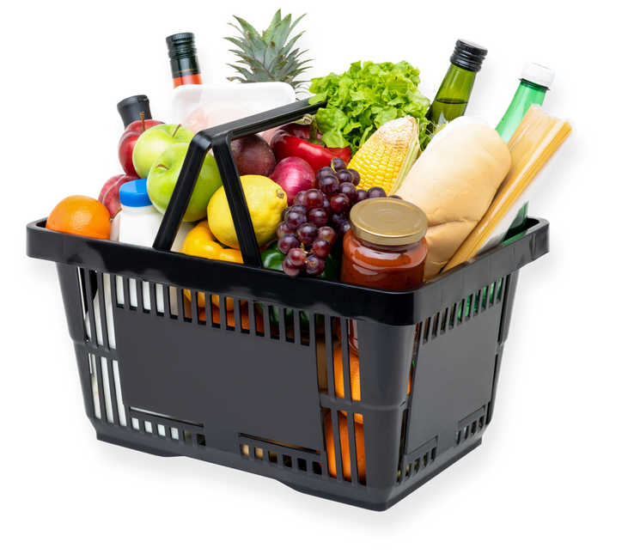

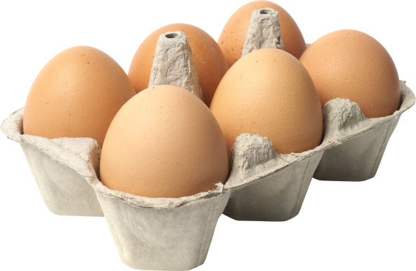
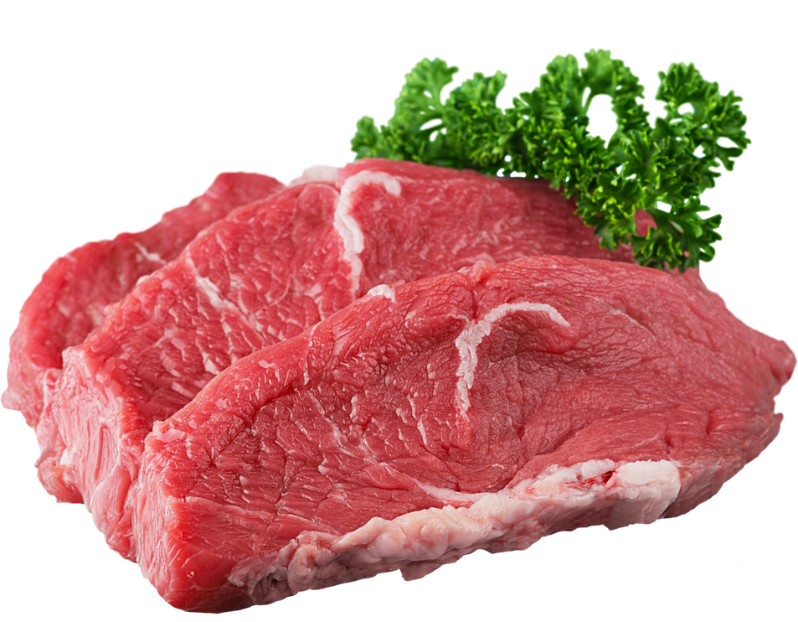
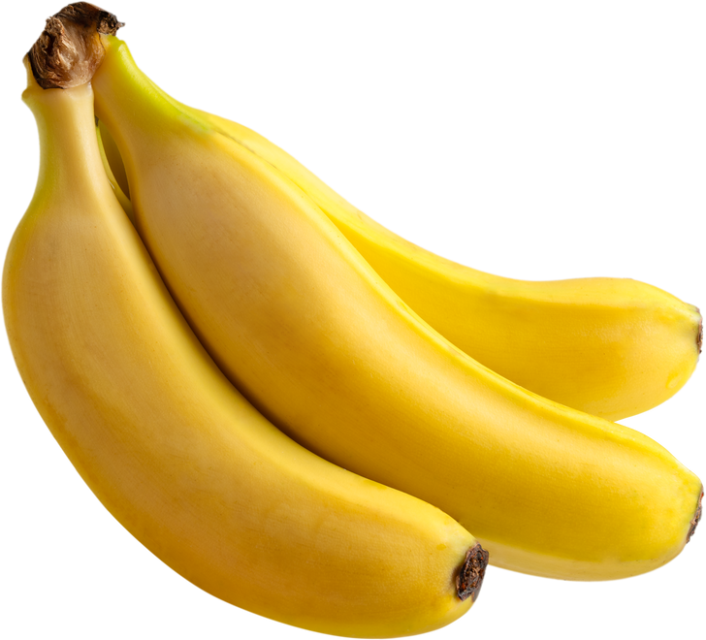
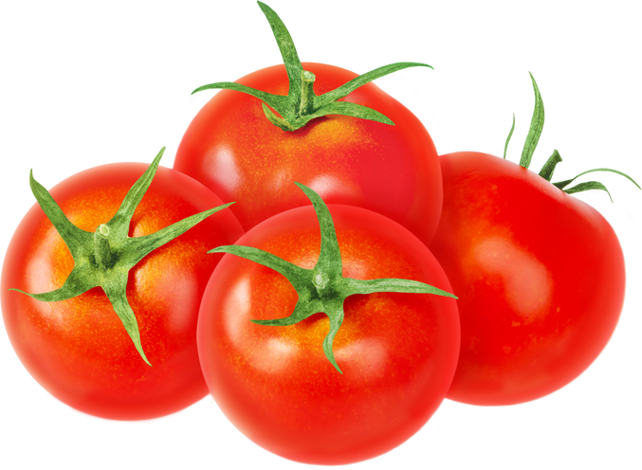
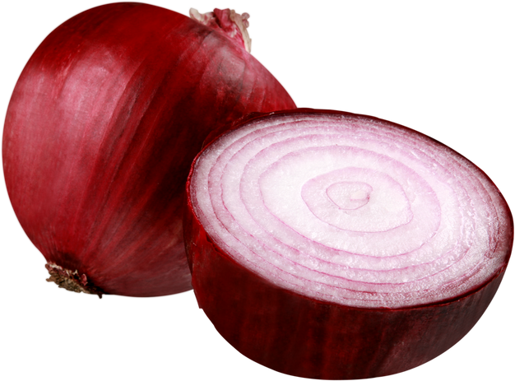
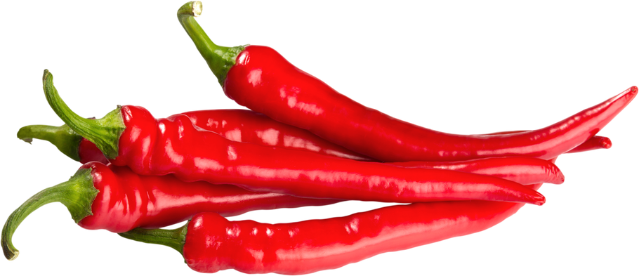
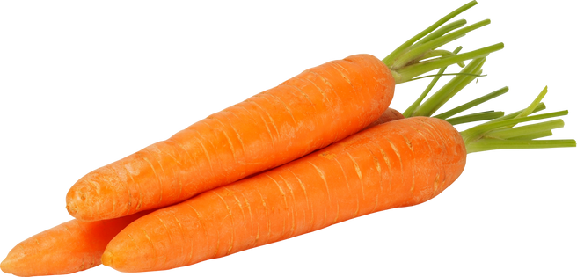
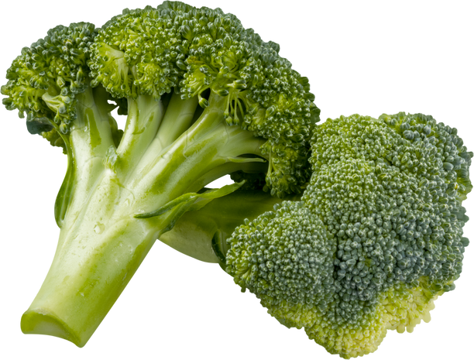



GROCERY
Rimberio
WEEKEND SALE
New Stock Every Day
Orange
$7
Eggs
$8
Beef
$10
500g
500g
500g
Fresh, sweet, rich in vitamins, perfectly enjoyed
High-quality fresh eggs are a natural source of protein.
Fresh, quality, and ready to be processed to perfection
Banana
$6
Tomato
$7
Onion
$9
500g
500g
500g
Sweet, fresh, nutrient-rich, versatile, and delicious
Perfect for salads, dressings, or healthy snacks
A versatile kitchen spice for a variety of dishes
Chili
$7
Carrots
$8
Broccoli
$8
500g
500g
500g
Perfect for adding a spicy flavor to your dishes
Fresh carrots rich in vitamins, suitable for healthy dishes
Fresh broccoli, rich in fiber, suitable for healthy dishes
123-456-7890
123 Anywhere St., Any City
www.reallygreatsite.com

