Slide 1

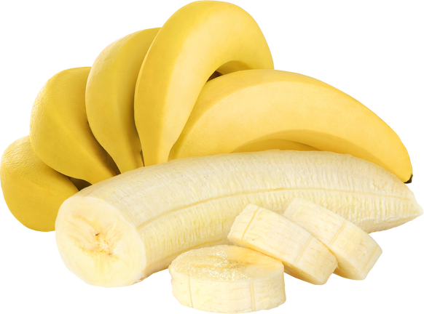
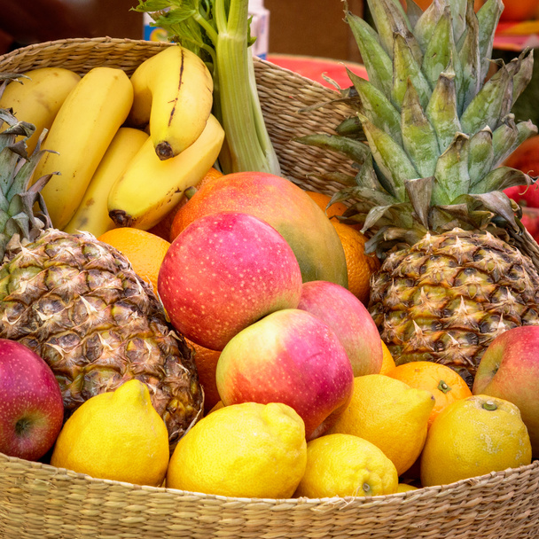
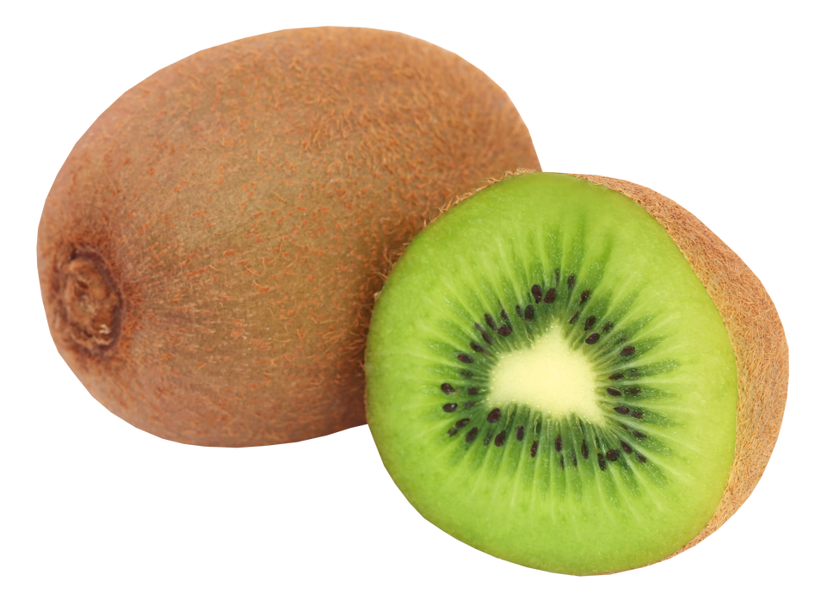
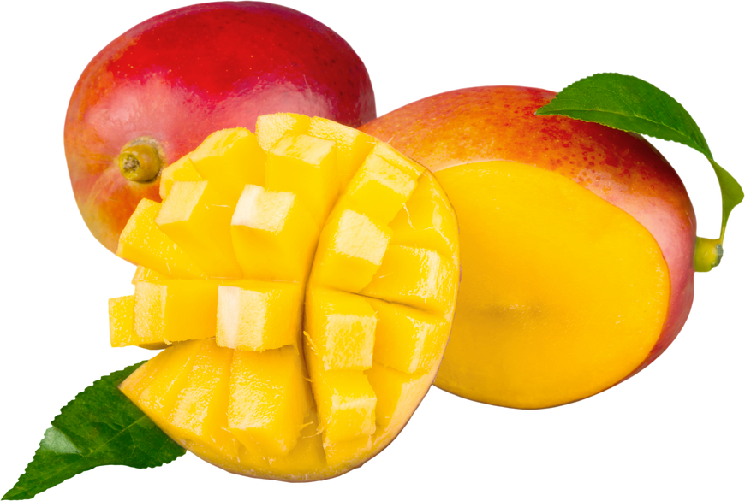
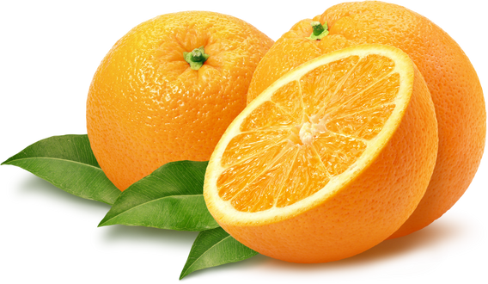
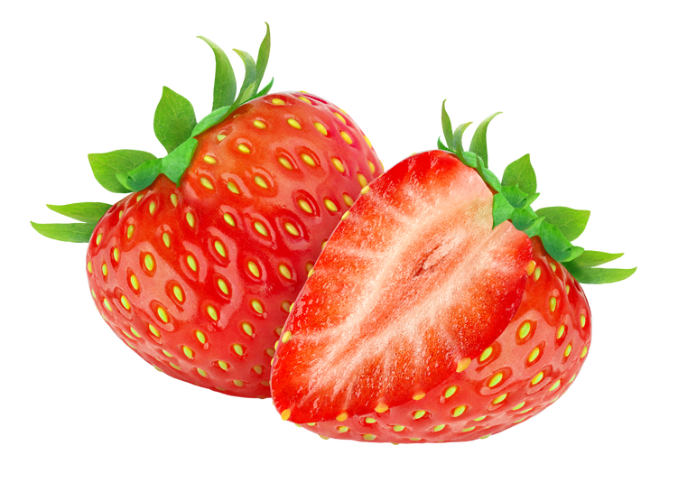
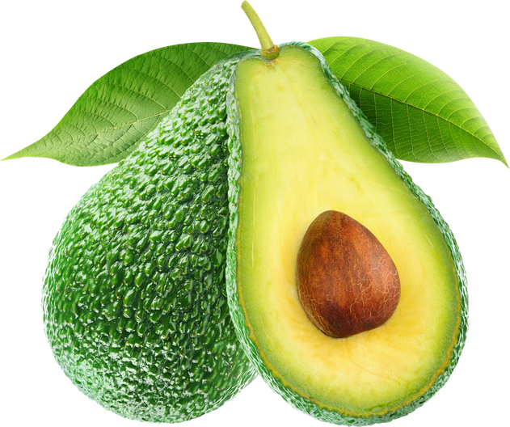
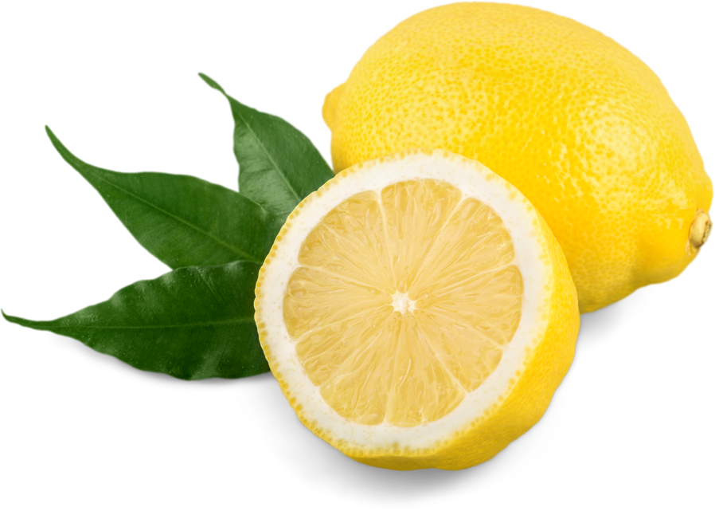


BIG SALE
$10
Discount 50% OFF
Banana
Fresh Product with Great Price
$18
Kiwi
$22
Mango
$10
$15
$20
$25
Orange
Strawberry
Avocado
Lemon
Call Us Now
For More Information
+123-456-7890
www.reallygreatsite.com

