Slide 1




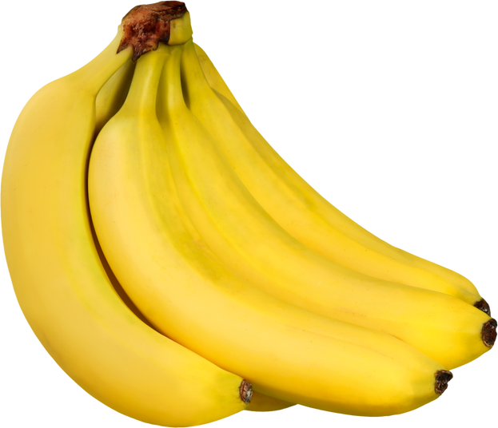

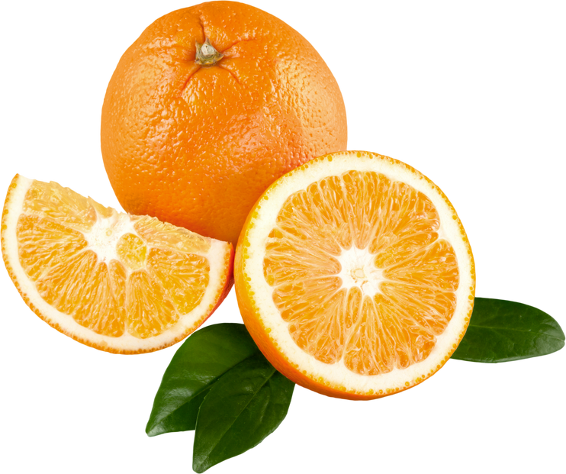
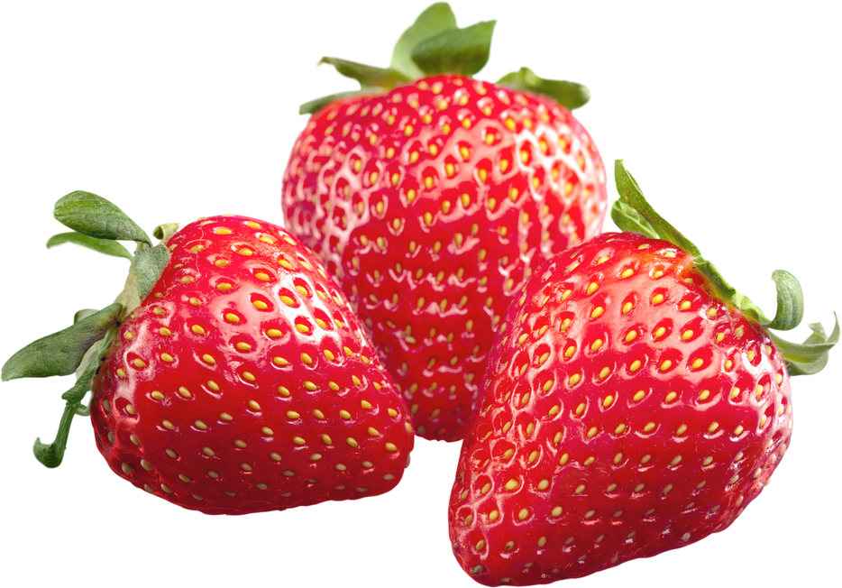




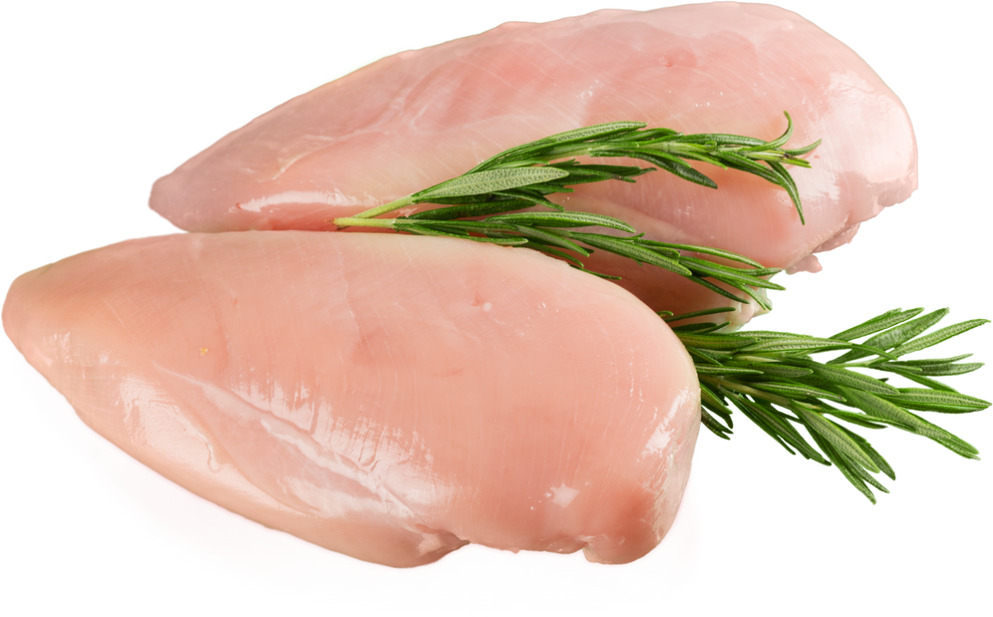
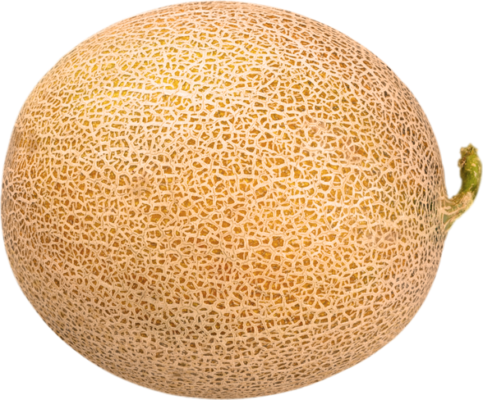

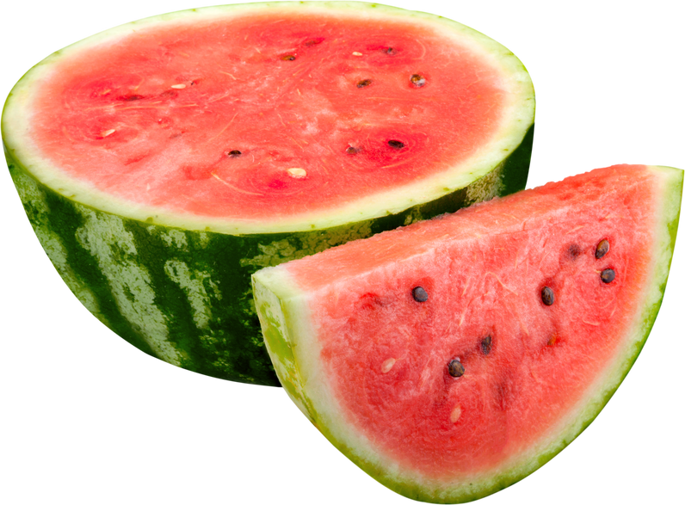
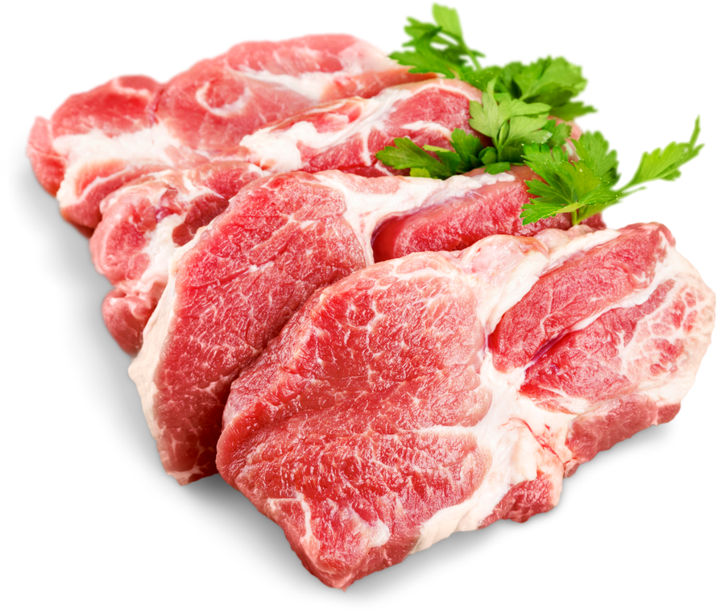



LIMITED OFFER
SPECIAL
BORCELLE
18TH - 28TH DECEMBER, 2024
DEALS
UP TO 50%
FRESH BANANAS
FRESH ORANGES
FRESH STRAWBERRY
$ 15.9
$ 15.9
$ 15.9
$ 9.4
$ 7.4
$ 8.4
SALE
SALE
SALE
BORCELLE BODY CARE PRODUCTS
SUPER SALE
CHICKEN BREAST
$ 21.5
$ 21.5
$ 26.4
$ 16.4
/ KG
FRESH WATERMELON
FRESH CANTALOUPE
CHICKEN EGGS
$ 15.9
$ 15.9
$ 15.9
$ 9.4
$ 7.4
$ 8.4
SALE
SALE
SALE
FRESH RAW BEEF
SUPER SALE
BORCELLE SOFT KITCHEN TOWEL
$ 21.5
$ 21.5
$ 16.4
$ 26.4
/ KG
www.reallygreatsite.com
Really Great Site
www.reallygreatsite.com

