Slide 1



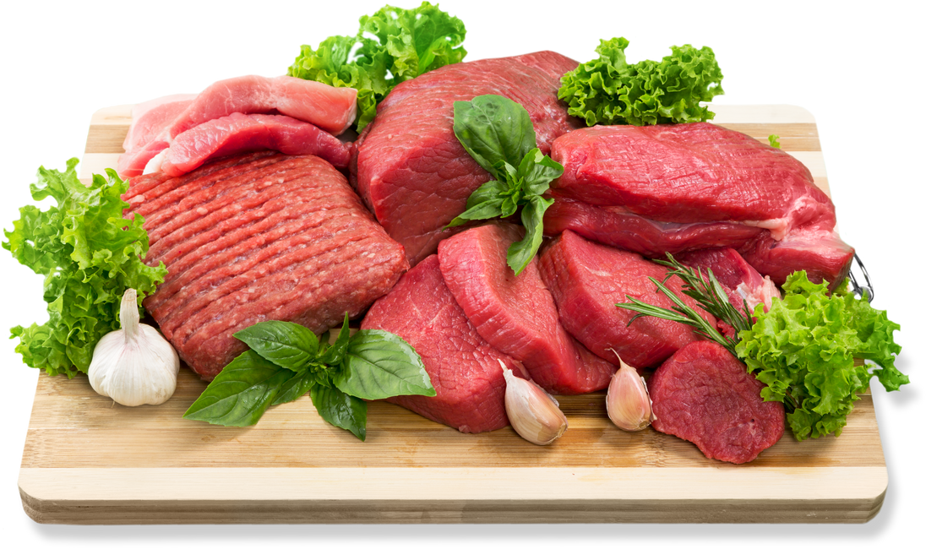








SPECIAL OFFER
GROCERY CATALOGUE
Up To 20% Off For All Illustrated
$10
$10
$10
Product Name
Product Name
Product Name
$10
$10
$10
Product Name
Product Name
Product Name
$10
$10
$10
Product Name
Product Name
Product Name
Check The Latest Loyalty Promo Via The Website
www.reallygreatsite.com

