Slide 1
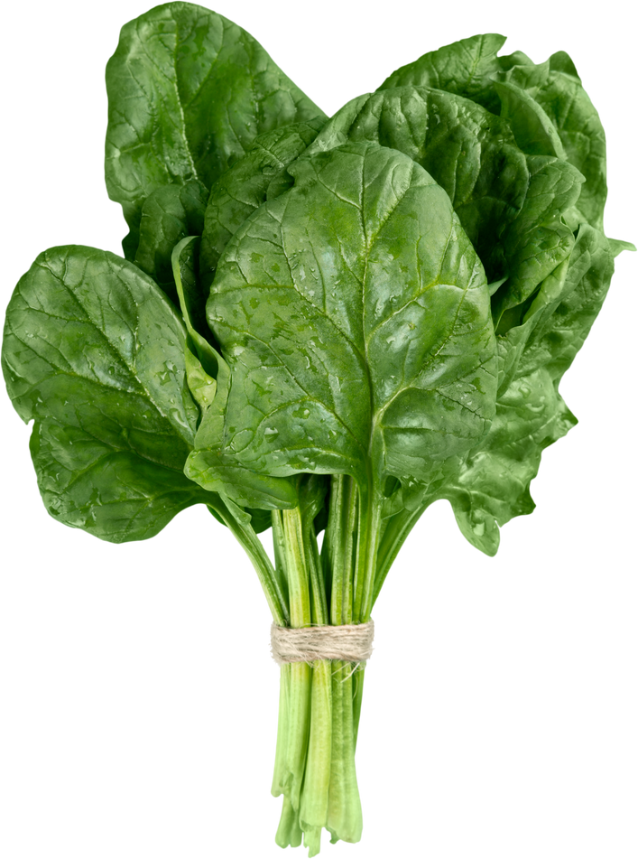
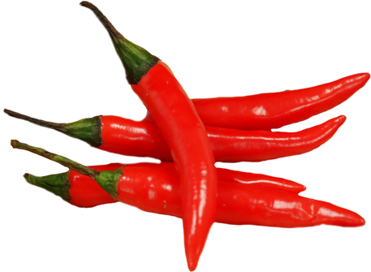
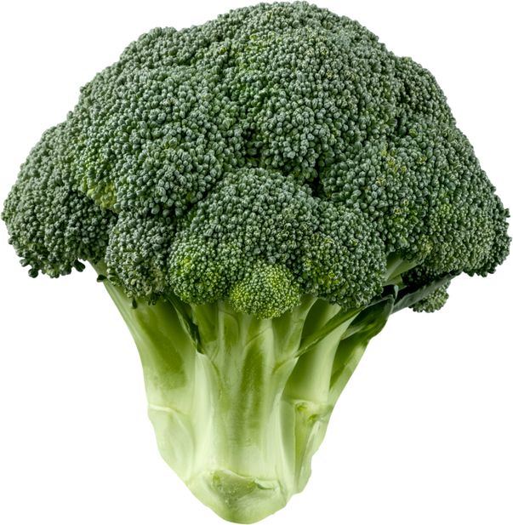
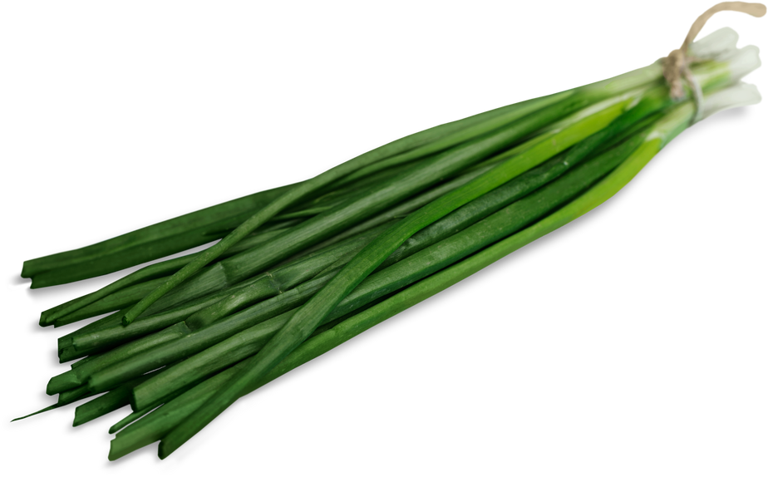
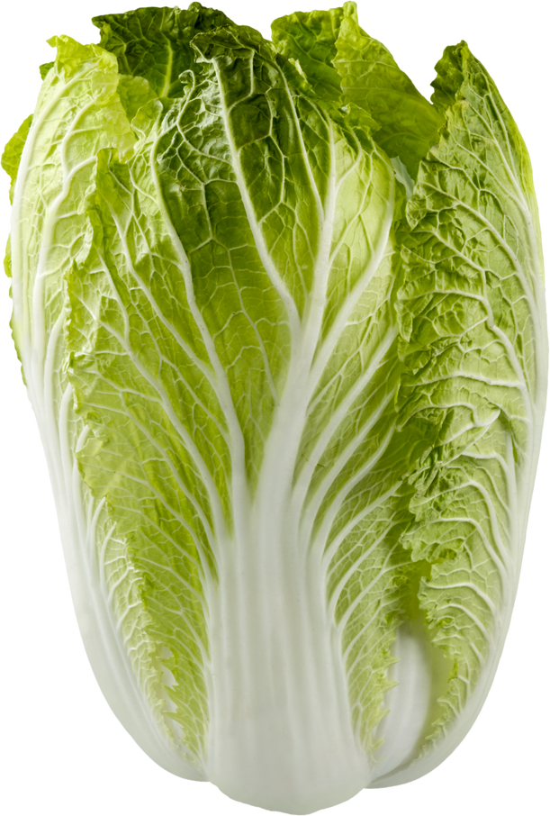
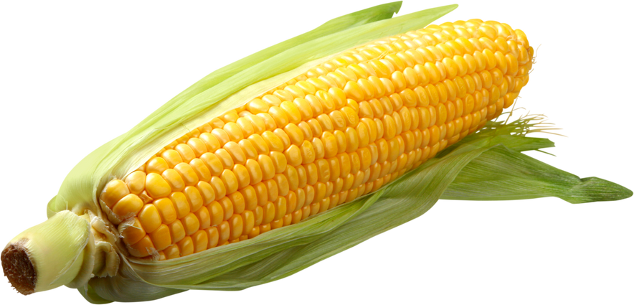
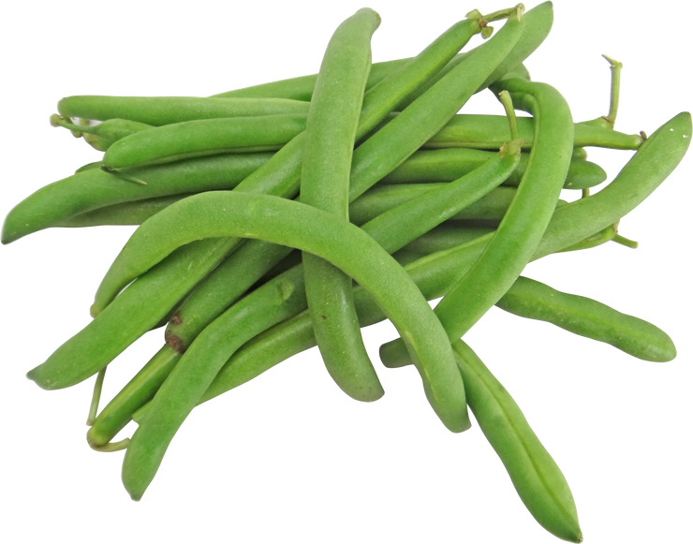
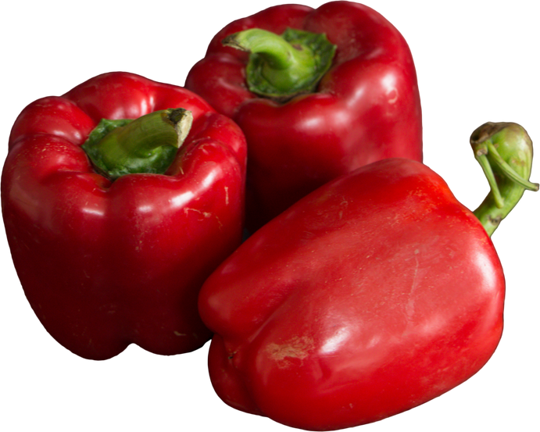
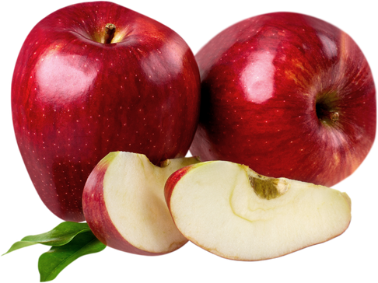
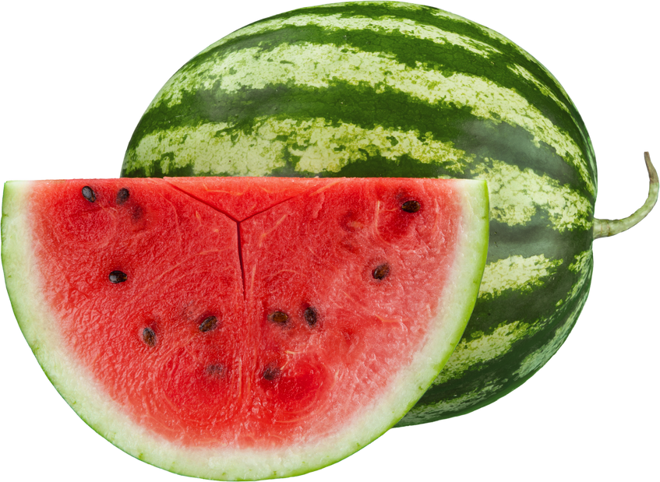




Grocery Weekend Sale
SAVE UP TO
70% OFF
30% OFF
30% OFF
30% OFF
30% OFF
Spinach
Chili
Broccoli
Chives
$ 12.00
$ 10.00
$ 12.00
$ 12.00
30% OFF
40% OFF
20% OFF
20% OFF
Cabbage
Sweet corn
Green Beans
Paprika
$ 13.00
$ 15.00
$ 14.00
$ 12.00
30% OFF
50% OFF
20% OFF
70% OFF
Apple
Water Melon
Orange
Strawberry
$ 12.00
$ 15.00
$ 12.00
$ 16.00
ORDER NOW
www.reallygreatsite.com
+123-456-7890

