Slide 1


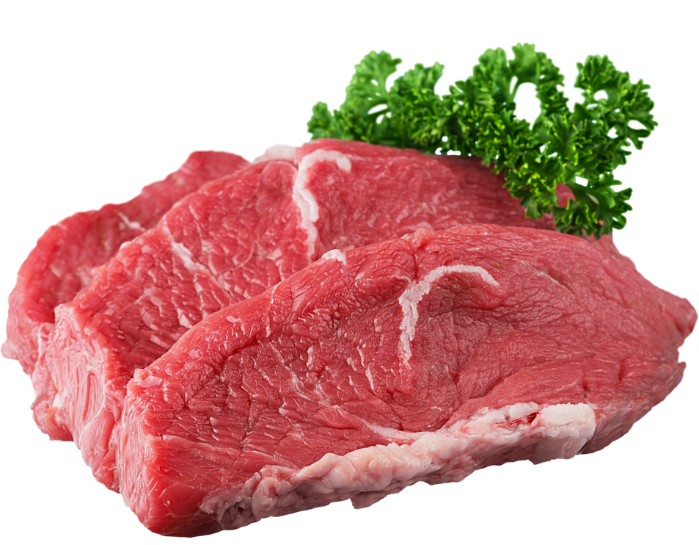
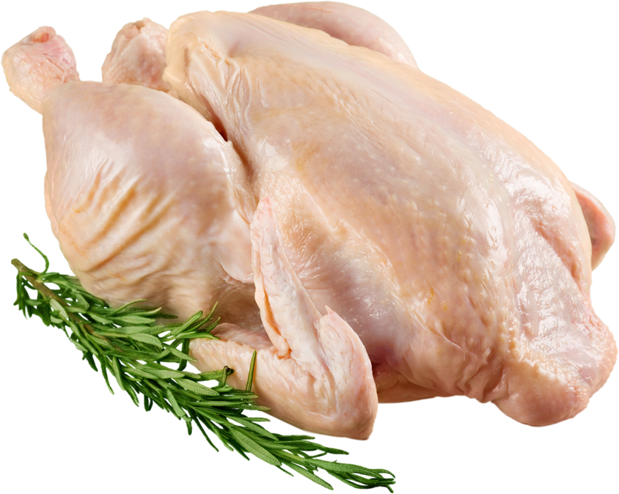
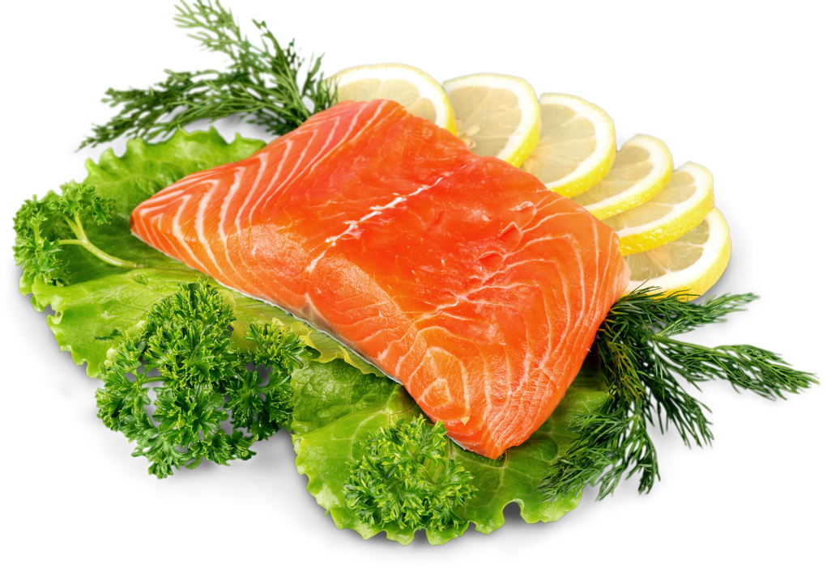
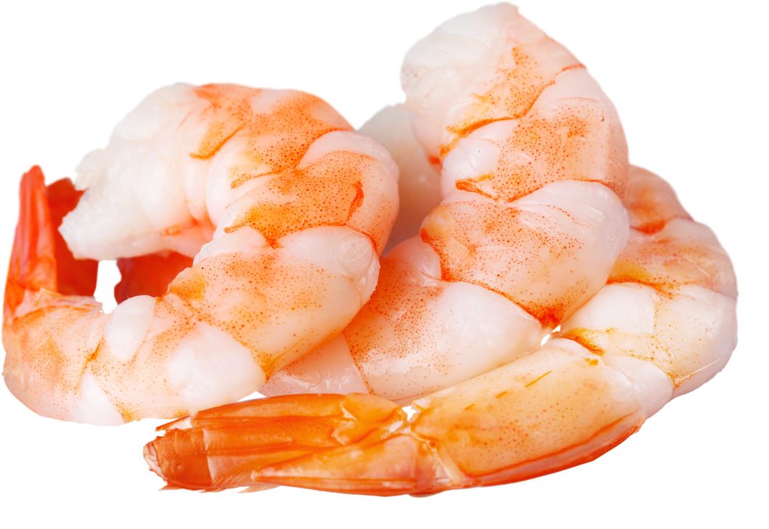
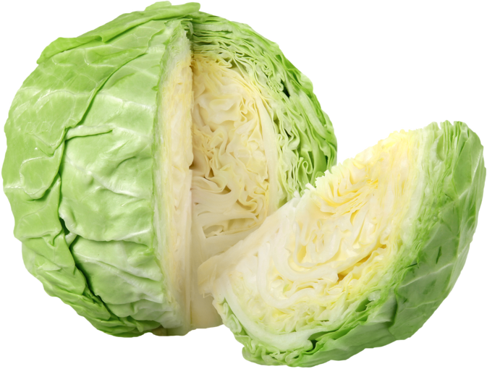
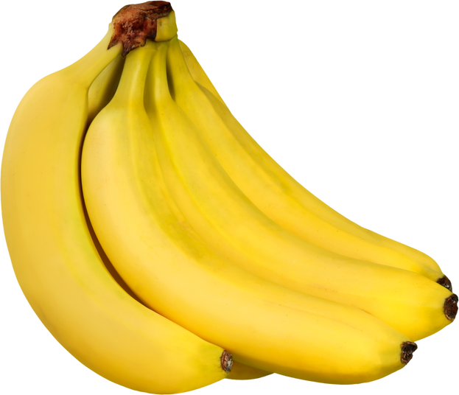
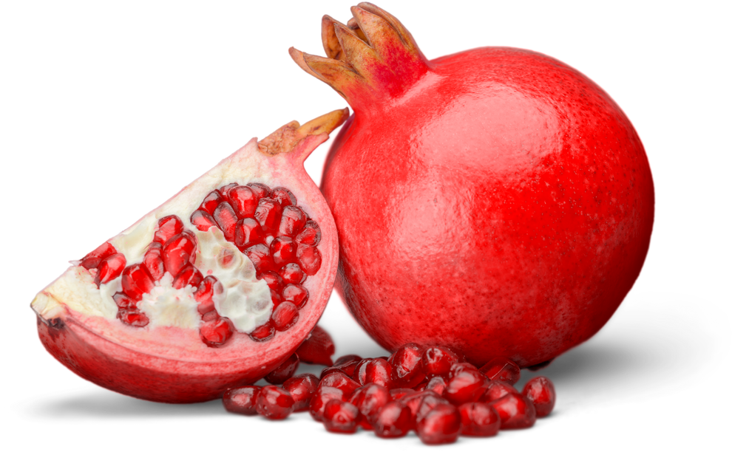
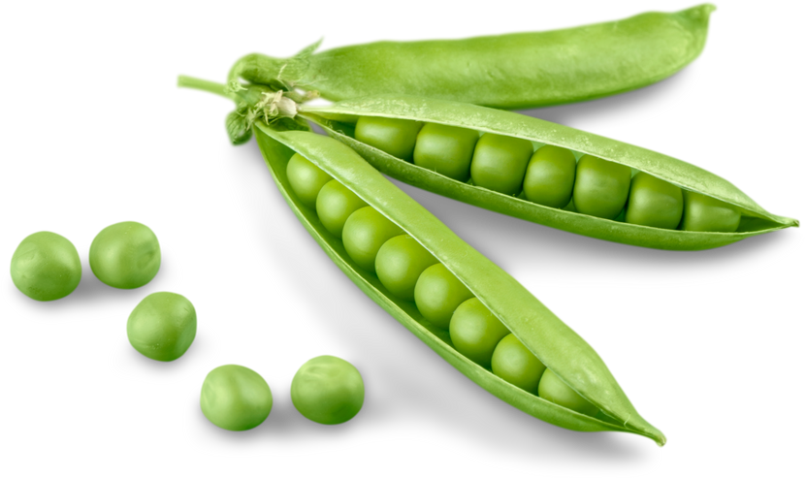
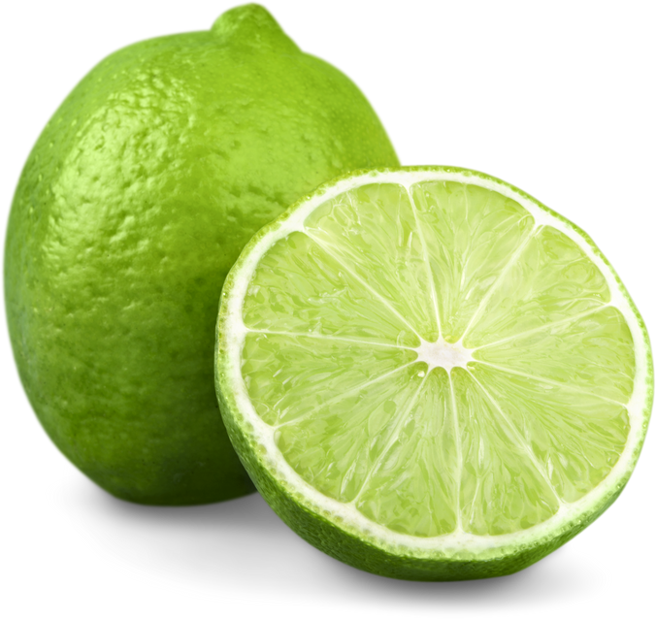
GROCERY
STUDIO
SHODWE
DEALS!
LIMITED ITEMS
UP TO 80% OFF
RAW BEEF MEAT
$12.20 / KG
WHOLE CHICKEN
$15.50 / KG
SLICED SALMON
$16.20 / KG
$ 10.50
$ 11.50
$ 15.50
RAW SHRIMP
$18.20 / KG
FRESH CABBAGE
$10.20 / KG
FRESH BANANA
$10.99 / KG
$ 14.50
$ 8.50
$ 7.99
FRESH POMEGRANATE
$18.20 / KG
ORGANIC GREEN PEAS
$11.20 / KG
GREEN CITRUS LIME
$12.50 / KG
$ 12.50
$ 10.50
$ 9.50
123 Anywhere St., Any City, ST. 1234
Available until: 28th October, 2025

