Slide 1







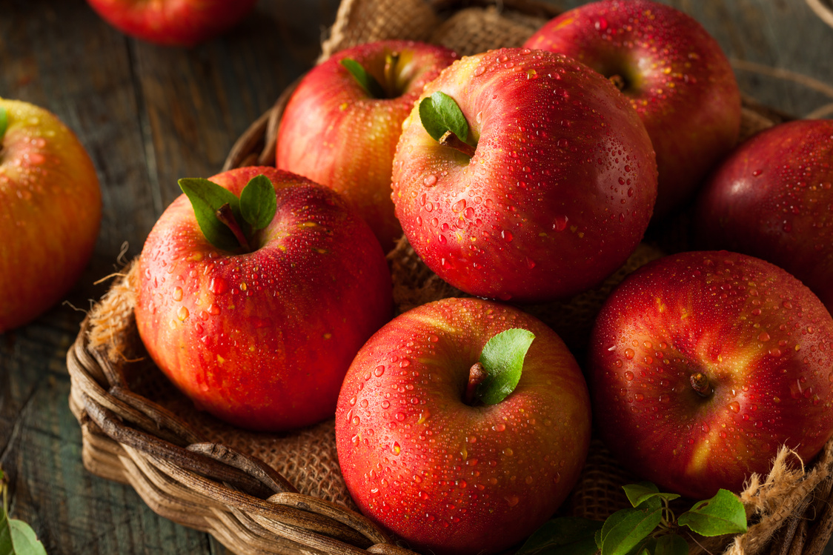

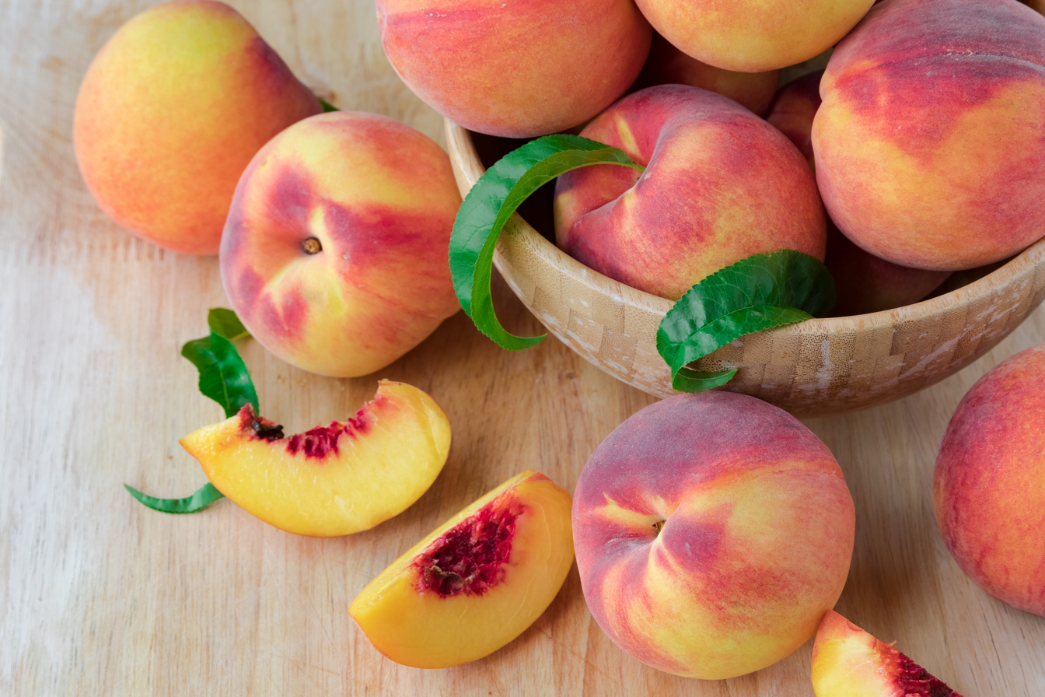


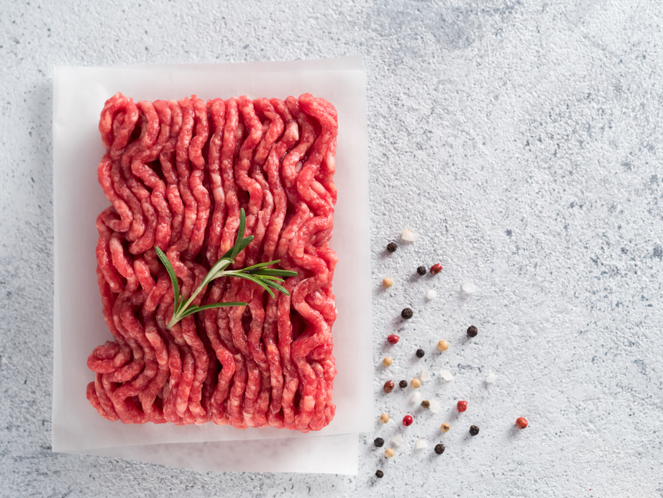
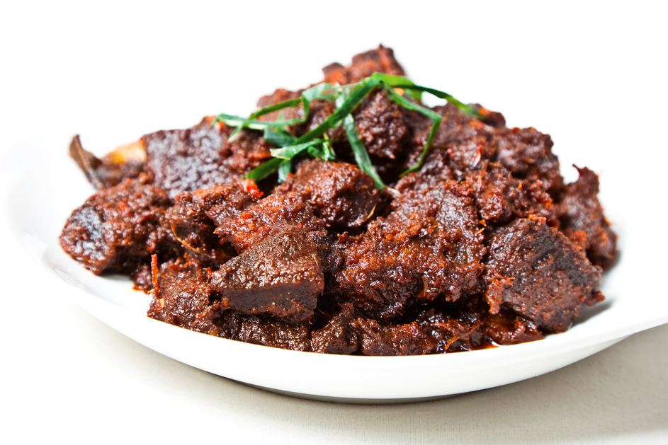
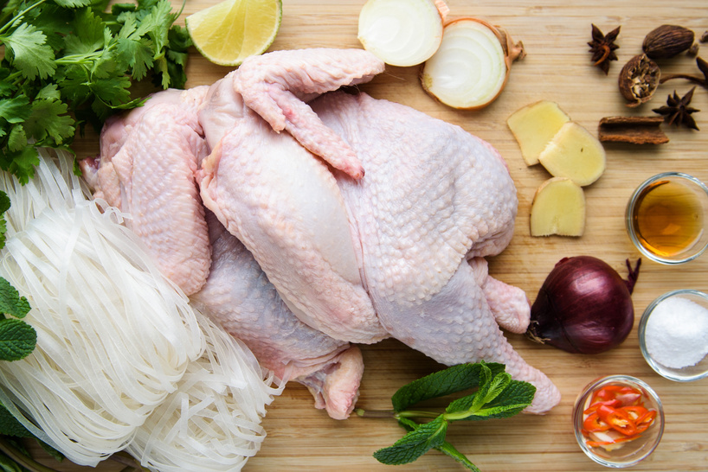

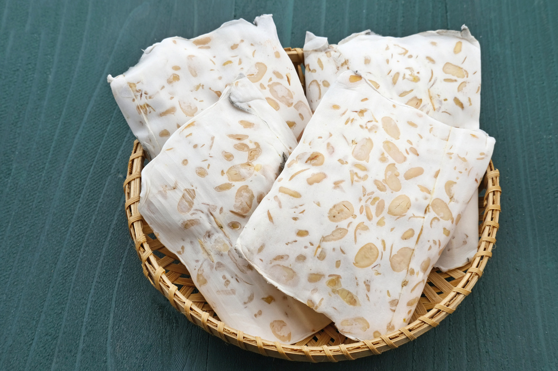
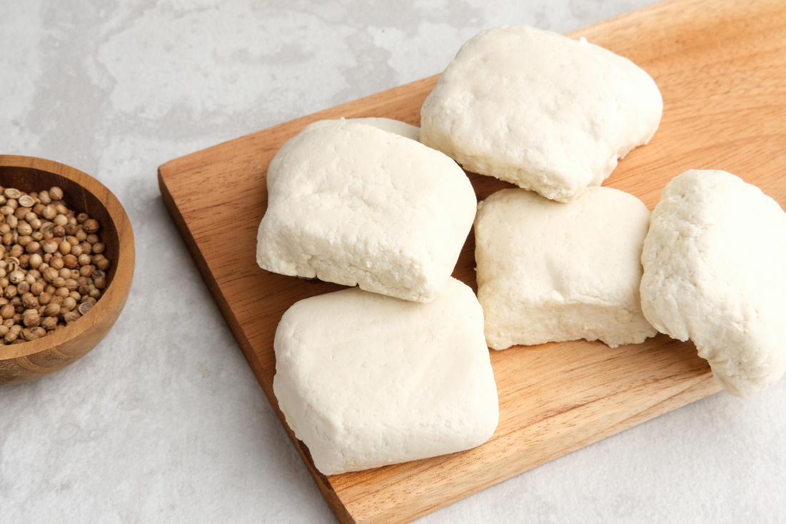

20%
OFF
GROCERY CATALOGUE
💥 Top-Quality Products 💥 Incredible Savings 💥 Offer Valid Until 31 December!
123-456-7890
123 Anywhere St., Any City, ST 12345
NOW $20
NOW $20
NOW $20
NOW $20
PRODUCT NAME
PRODUCT NAME
PRODUCT NAME
PRODUCT NAME
Regular Price
$40
Regular Price
$40
Regular Price
$40
Regular Price
$40
NOW $20
NOW $20
NOW $20
NOW $20
PRODUCT NAME
PRODUCT NAME
PRODUCT NAME
PRODUCT NAME
Regular Price
$40
Regular Price
$40
Regular Price
$40
Regular Price
$40
NOW $20
NOW $20
NOW $20
NOW $20
PRODUCT NAME
PRODUCT NAME
PRODUCT NAME
PRODUCT NAME
Regular Price
$40
Regular Price
$40
Regular Price
$40
Regular Price
$40

