Slide 1




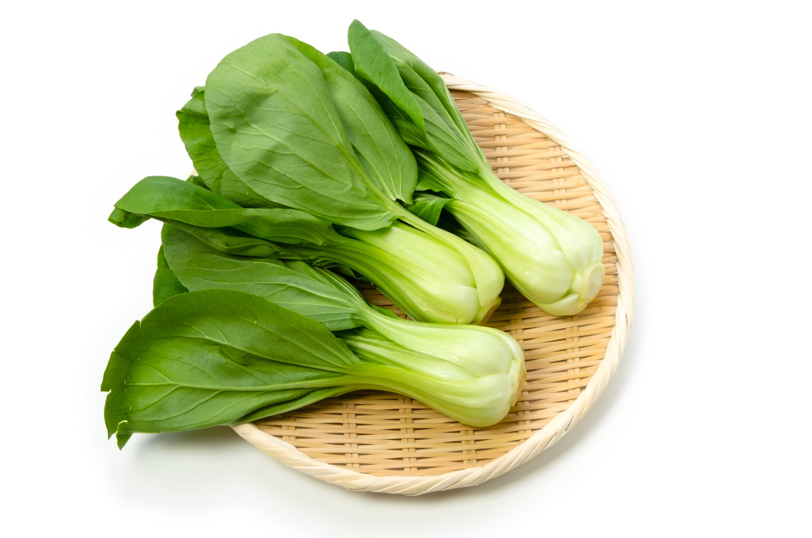
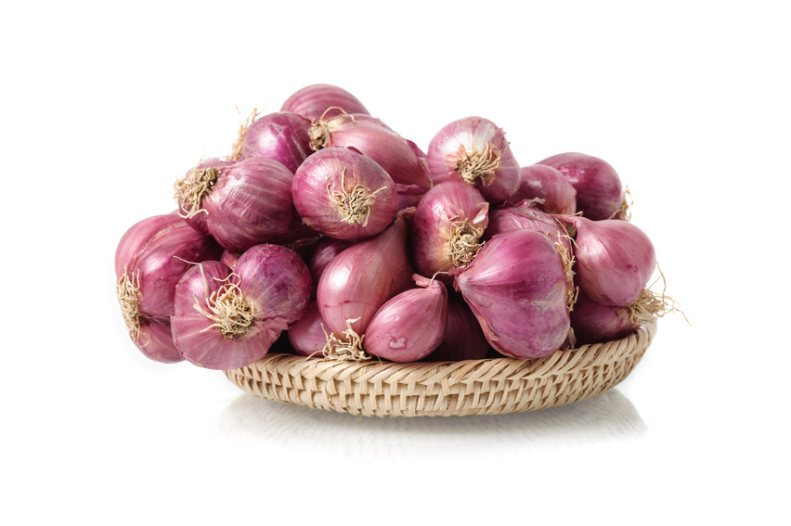
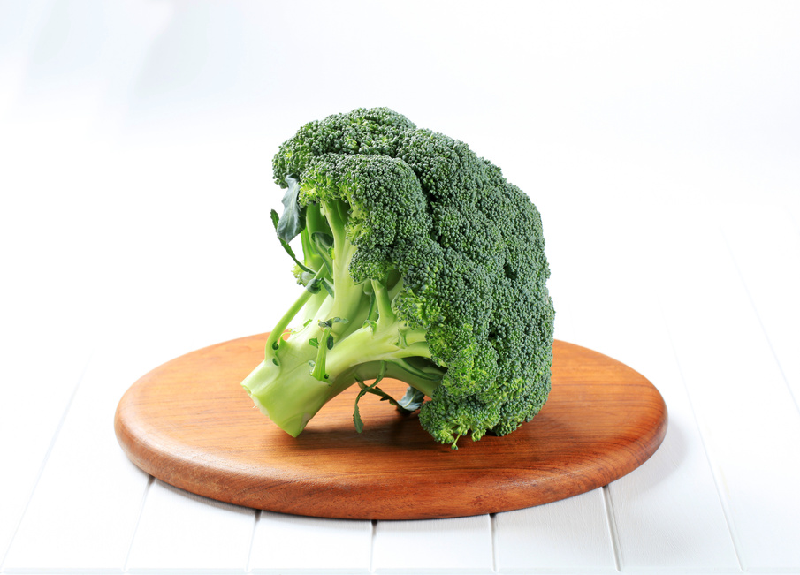
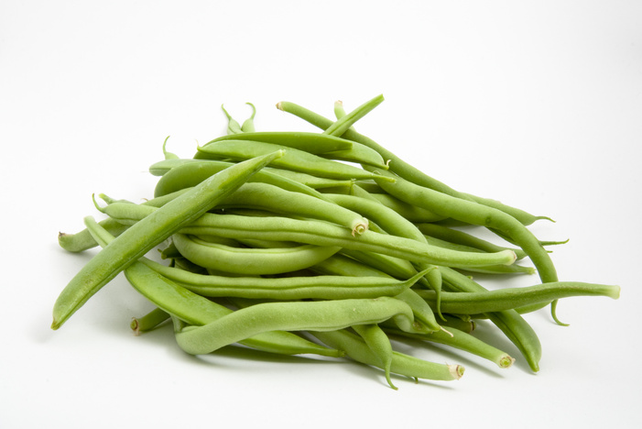
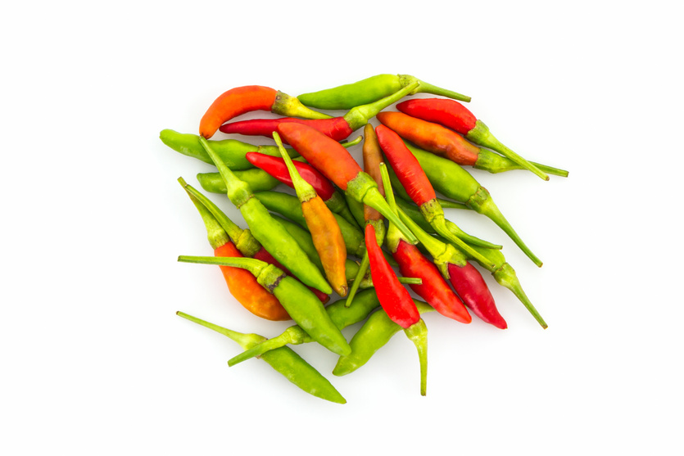
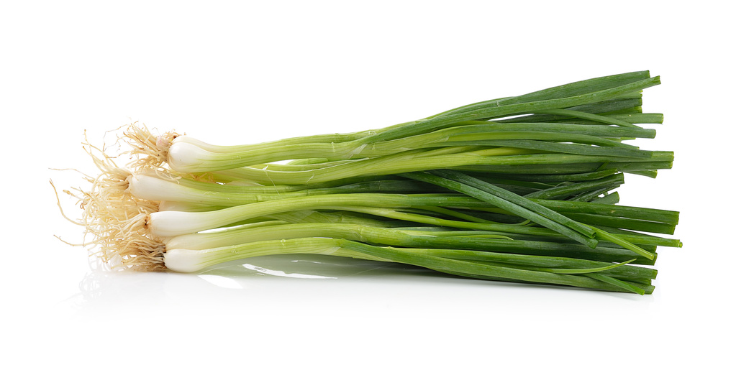
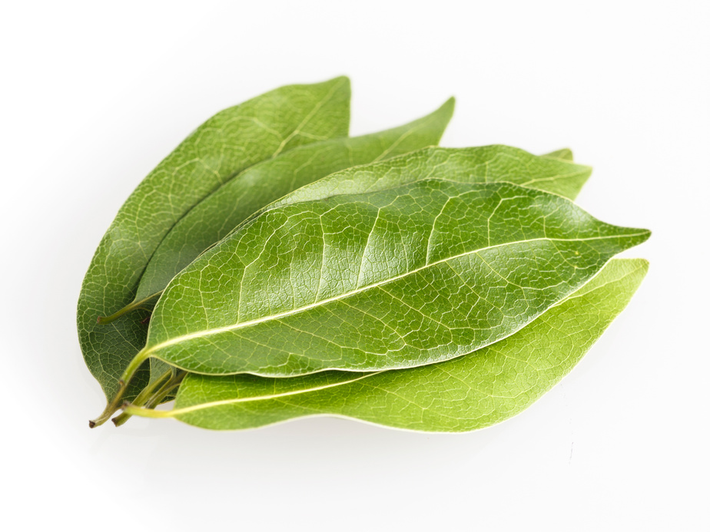

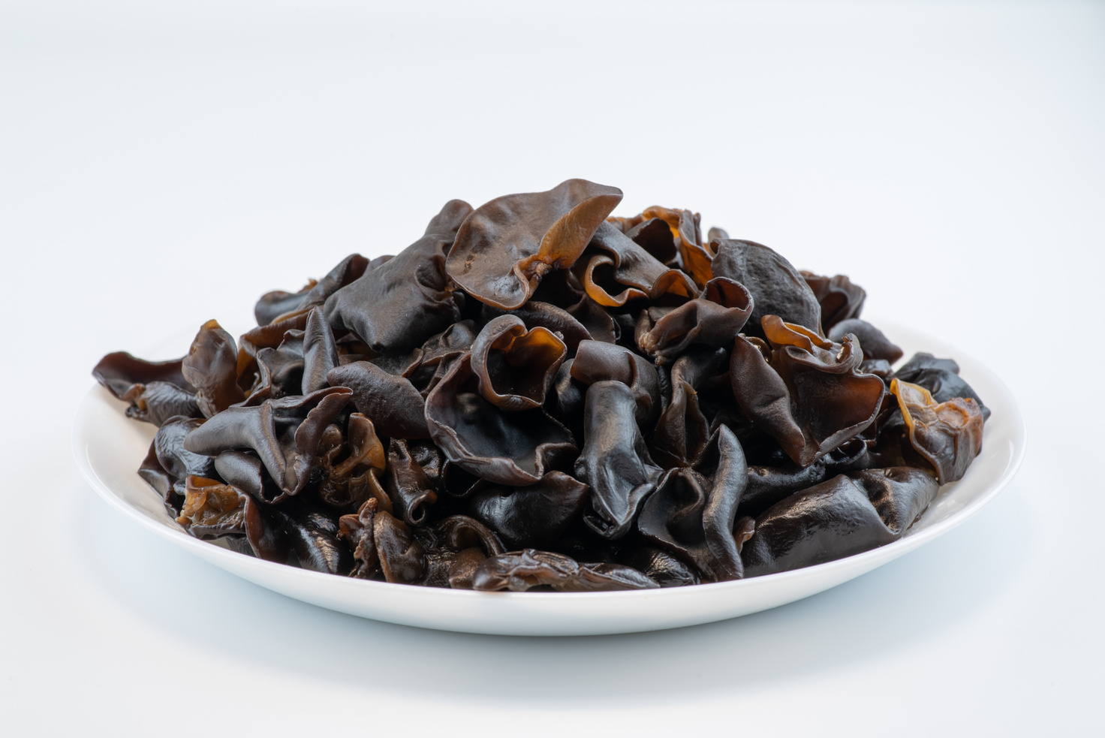
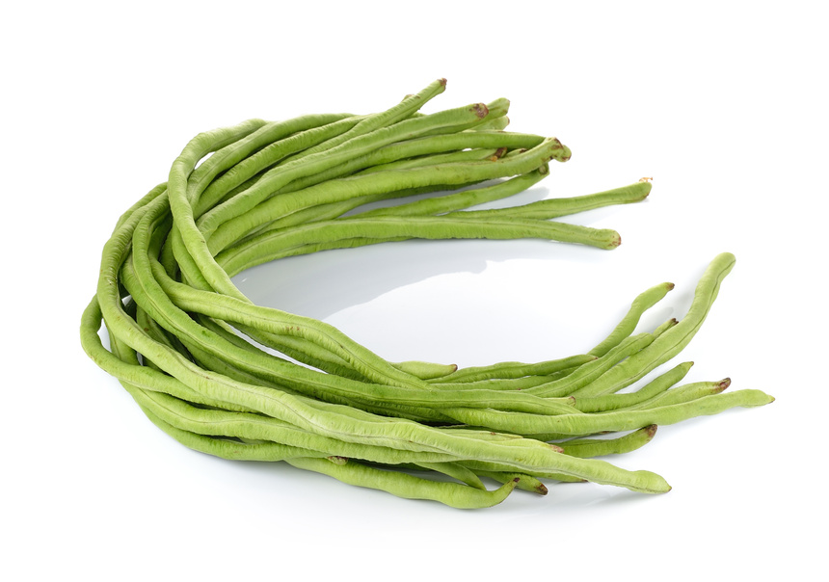
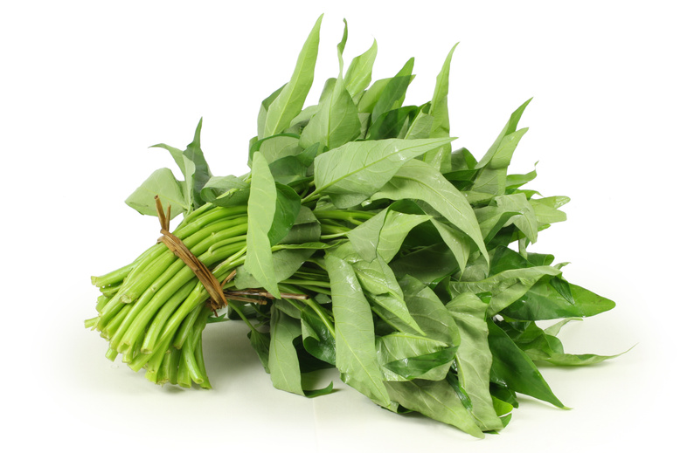
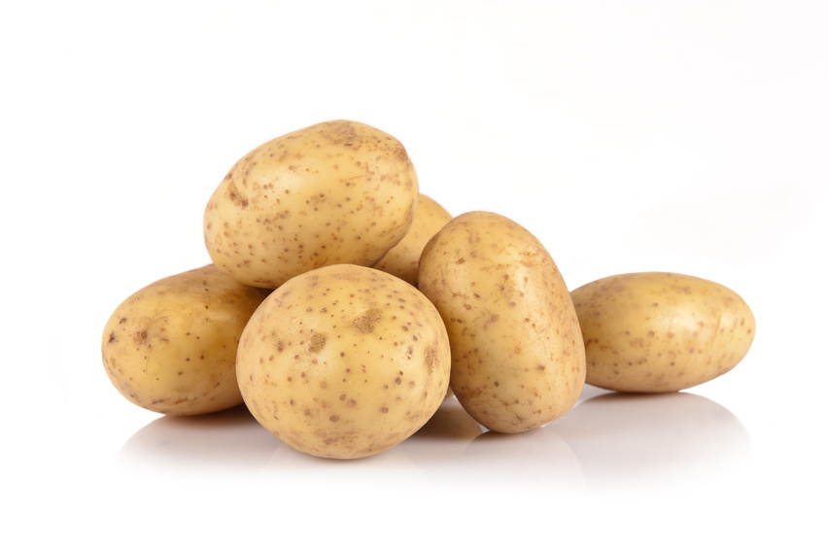

FRESH VEGETABLES
FREE
PAUCEK AND LAGE MART
delivery for Liceria district & nearby areas
Fresh, Convenient, and High-Quality
FRESH PICKS
BABY BOK CHOY
1 kg
SHALLOTS
1 kg
BROCCOLI
1 kg
$
0.85
$
2.03
$
1.14
GREEN BEANS
500g
GREEN BIRD’S EYE CHILI
1 kg
SPRING ONION
250g
$
0.44
$
1.08
$
0.32
BAY LEAVES
200g
GINGER
500g
WOOD EAR MUSHROOM
300g
$
$0.10
$
1.52
$
0.47
LONG BEANS
1 kg
WATER SPINACH
500g
POTATOES
1 kg
$
0.98
$
0.38
$
1.01
We also offer
A variety of kitchen spices, leafy greens, root vegetables, mushrooms, and aromatic herbs
All fresh, All local!
Paucek and Lage
123 Anywhere St., Any City, ST 12345
Place your order now
+123-456-7890

